Slide 1
CSC 112: Computer Operating Systems
Lecture 6
Real-Time Scheduling II
Department of Computer Science,
Hofstra University
Acknowledgement: Lecture slides based on Buttazzo, Hard Real-Time Computing Systems

Slide 2
Outline
Part I
  Introduction to RTOS and Real-Time Scheduling
  Fixed-Priority Scheduling
  Earliest Deadline First Scheduling
  Least Laxity First (LLF) Scheduling
  Preemptive vs. Non-Preemptive Scheduling
Part II
  Multiprocessor Scheduling
  Resource Synchronization Protocols (for Fixed-Priority Scheduling)

Slide 3
Multiprocessor Scheduling

Slide 4
Multiprocessor models
Identical multiprocessors:
  each processor has the same computing capacity
Uniform multiprocessors:
  different processors have different computing capacities
Heterogeneous multiprocessors:
  each (task, processor) pair may have a different computing capacity
MP scheduling
  Many NP-hard problems, with few optimal results, mainly heuristic approaches
  Only sufficient schedulability tests

Slide 5
Multiprocessor Models
Identical multiprocessors: each processor has the same speed
Task T1
Task T2
P1
P2
P3

Slide 6
Multiprocessor Models
Uniform multiprocessors: different processors have different speeds
Task T1
Task T2
y
y/2
y/3
x
x/2
x/3
P1
P2
P3
speed = 1
speed = 2
speed = 3

Slide 7
Multiprocessor Models
Heterogeneous multiprocessors: each (task, processor) pair may have a different relative speed, due to specialized processor architectures
Task T1
Task T2
y
y
1.5 y
Number-crunching task:
x
x/2
x/2
x/3
x/3
Graphics-intensive task:
CPU
DSP chip
Graphics co-processor

Slide 8
Global vs partitioned scheduling
Global scheduling
  All ready jobs are kept in a common (global) queue; when selected for execution, a job can be dispatched to an arbitrary processor, even after being preempted
Partitioned scheduling
  Each task may only execute on a specific processor
Global scheduling:
Single system-wide queue
Partitioned scheduling:
per-processor queues
CPU1
τ₁
CPU1
τ₁
τ₅
τ₄
τ₁
τ₅
τ₄
τ₃
τ₂
τ₁
CPU2
τ₂
τ₃
τ₂
CPU2
τ₂
CPU3
τ₃
CPU3
Notes:
A task may execute on any processor
A preempted job may resume on any processor
All ready tasks are kept in a common (global) queue
When selected for execution, a task can be dispatched to an arbitrary processor, even after being preempted
Single system-wide queue or multiple per-processor queues:

Slide 9
Global Scheduling vs. Partitioned Scheduling
Global Scheduling
Pros:
  Runtime load-balancing across cores
    More effective utilization of processors and overload management
  Supported by most multiprocessor operating systems
    Windows, Linux, MacOS...
Cons:
  Low schedulable utilization
  Weak theoretical framework
Partitioned Scheduling
Pros:
  Mature scheduling framework
  Uniprocessor scheduling theory is applicable on each core; uniprocessor resource access protocols (PIP, PCP…) can be used
  Partitioning of tasks can be done by efficient bin-packing algorithms
Cons:
  No runtime load-balancing; surplus CPU time cannot be shared among processors
Notes:
Unused processor time can easily be reclaimed
Easier re-scheduling (dynamic loads, selective shutdown, etc.)
Number of preemptions
Weak theoretical framework
Migration cost: can be mitigated by proper HW (e.g., MPCore’s Direct Data Intervention)
• Poor resource utilization for hard timing constraints
– No more than 50% resource utilization can be guaranteed
• Suffers from several scheduling anomalies
– Sensitive to period adjustments
Lower average response time

Slide 10

Partitioned Scheduling
Scheduling problem reduces to:
Bin-packing
problem
+
Uniprocessor
scheduling
problem
τ₁
τ₃
τ₅
τ₂
τ₄
NP-hard
Well-known
Various heuristic algorithms
First Fit (FF)
Best Fit (BF)
Worst Fit (WF)
Next Fit (NF)
…
EDF
U ≤ 1
RM
(RTA)
...
Notes:
FF, NF, BF, FFDU, BFDD, etc.
in the
strong sense
Global (work-conserving) and partitioned approaches are incomparable
Two steps:
1. Determine a mapping of tasks to processors
2. Perform run-time scheduling
The Earliest Deadline First (EDF) scheduling algorithm
- provably optimal (utilization bound = 1.0) on uniprocessors
Partitioned with EDF 
Assign tasks to the processors, such that no processor’s capacity is exceeded
Schedule each processor using EDF

Slide 11
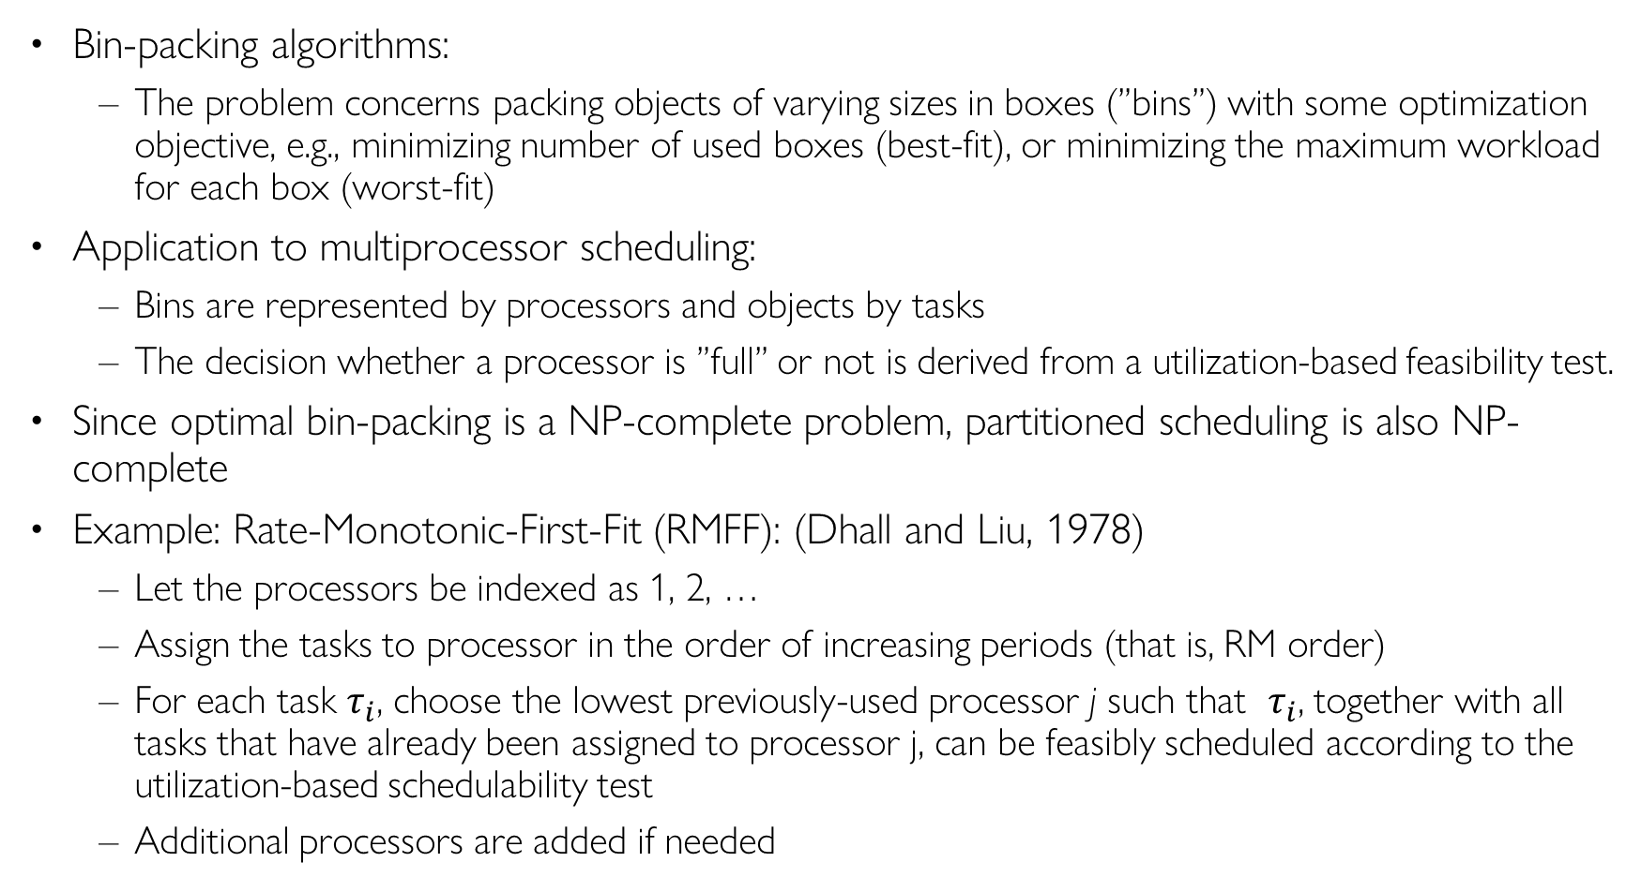
Partitioned Scheduling
Bin-packing algorithms:
  The problem concerns packing objects of varying sizes in boxes (“bins”) with some optimization objective, e.g., minimizing number of used boxes (best-fit), or minimizing the maximum workload for each box (worst-fit)
Application to multiprocessor scheduling:
  Bins are represented by processors and objects by tasks
  The decision whether a processor is “full” or not is derived from a utilization-based feasibility test.
Since optimal bin-packing is an NP-complete problem, partitioned scheduling is also NP-complete
Example: Rate-Monotonic-First-Fit (RMFF): (Dhall and Liu, 1978)
  Let the processors be indexed as 1, 2, …
  Assign the tasks to processor in the order of increasing periods (that is, RM order)
  For each task $τ_{i}$, choose the lowest previously-used processor j such that $τ_{i}$, together with all tasks that have already been assigned to processor j, can be feasibly scheduled according to the utilization-based schedulability test
  Additional processors are added if needed
Notes:
Complexity of schedulability analysis for partitioned scheduling: (Leung & Whitehead, 1982)
The problem of deciding whether a task set is schedulable on m processors with respect to partitioned scheduling is NP-complete
Consequence:
There cannot be any pseudo-polynomial time algorithm for finding an optimal partition of a set of tasks unless P = NP.
Assumptions:
Independent, periodic tasks
Preemptive, uniprocessor scheduling (RM)

Slide 12
Assumptions for Global Scheduling
Identical multiprocessors
Work-conserving:
  At each instant, the highest-priority jobs that are eligible to execute are selected for execution upon the available processors
  No processor is ever idle when the ready queue is non-empty
Preemption and Migration support
  A preempted task can resume execution on a different processor with 0 overhead, as cost of preemption/migration is integrated into task WCET
No job-level parallelism
  the same job cannot be simultaneously executed on more than one processor, i.e., we do not consider parallel programs that can run on multiple processors in parallel
Notes:
The m highest priority ready jobs are always executing on m processors
Work-conserving scheduler
No processor is ever idle when the ready queue is non-empty
Independent tasks
The independence assumption can be later removed, considering blocking times and shared resource protocols.
a processor is never left idle while an active job exists
Task execution is assumed to be “greedy”:
If higher-priority tasks occupy all processors, a lower-priority task cannot grab a processor until the execution of a higher priority task is complete.

Slide 13
Source of Difficulty
The “no job-level parallelism” assumption leads to difficult scheduling problems
“The simple fact that a task can use only one processor even when several processors are free at the same time adds a surprising amount of difficulty to the scheduling of multiple processors” [Liu’69]
CPU1
CPU2
CPU3
Notes:
The ”root of all evil” in global scheduling: (Liu, 1969)
Few of the results obtained for a single processor generalize directly to the multiple processor case; bringing in additional processors adds a new dimension to the scheduling problem. The simple fact that a task can use only one processor even when several processors are free at the same time adds a surprising amount of difficulty to the scheduling of multiple processors.

Slide 14
Global scheduling example
CPU1
τ₁
Global ready queue
(ordered according to a given policy, e.g., RM/DM/EDF)
CPU2
τ₅
τ₄
τ₃
τ₂
τ₁
τ₂
CPU3
τ₃
The first m jobs in the queue are scheduled upon the m CPUs
Notes:
There is a global queue in which ready tasks ready are placed, according to a certain policy. When there is a free CPU the first task is removed from the queue and is scheduled. When a new task arrives with priority higher than one of the executing tasks, it preempts the executing task with lowest priority. If a task on a different CPU finishes its execution, the preempted task can “migrate” to the free CPU and continue its execution.

Slide 15

Global scheduling example
CPU1
τ₁
Global ready queue
(ordered according to a given policy, e.g., RM/DM/EDF)
CPU2
τ₅
τ₄
τ₂
τ₅
τ₃
τ₃
τ₄
τ₂
τ₂
τ₁
τ₁
CPU3
τ₃
τ₄
When a job $τ_{3}$ finishes its execution, the next job in the queue $τ_{4}$ is scheduled on the available CPU

Slide 16
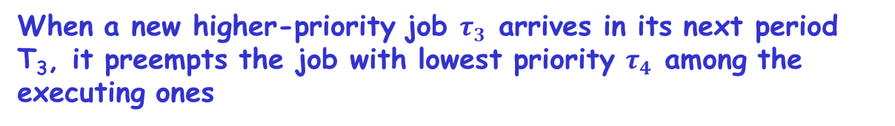
Global scheduling example
CPU1
τ₁
Global ready queue
(ordered according to a given policy, e.g., RM/DM/EDF)
CPU2
τ₅
τ₅
τ₂
τ₄
τ₃
τ₄
τ₃
τ3
τ₂
τ₂
τ₁
τ₁
τ₃
CPU3
τ₄
τ3
When a new higher-priority job $τ_{3}$ arrives in its next period T₃, it preempts the job with lowest priority $τ_{4}$ among the executing ones

Slide 17
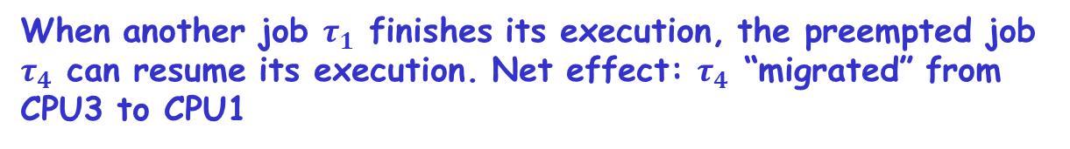
Global scheduling example
CPU1
τ₁
τ₄
Global ready queue
(ordered according to a given policy, e.g., RM/DM/EDF)
CPU2
τ₅
τ₄
τ₂
τ₅
τ₃
τ₄
τ₃
τ₃
τ₄
τ₂
τ₃
τ₁
τ₂
CPU3
τ₄
τ3
When another job $τ_{1}$ finishes its execution, the preempted job $τ_{4}$ can resume its execution. Net effect: $τ_{4}$ “migrated” from
CPU3 to CPU1

Slide 18
Global vs. Partitioned
Global (work-conserving) and partitioned scheduling algorithms are incomparable:
  There are tasksets that are schedulable with a global scheduler, but not with a partitioned scheduler, and vice versa.

Slide 19
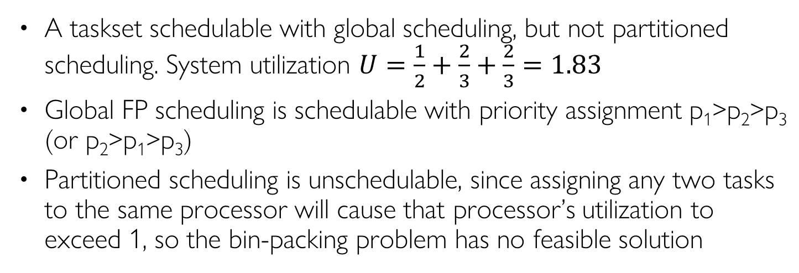
Global vs Partitioned (FP) Scheduling
Task | T=D | C | Prio
T1 | 2 | 1 | H
T2 | 3 | 2 | M
T3 | 3 | 2 | L
A taskset schedulable with global scheduling, but not partitioned scheduling. System utilization $U=\frac{1}{2}+\frac{2}{3}+\frac{2}{3}=1.83$
Global FP scheduling is schedulable with priority assignment p₁>p₂>p₃ (or p₂>p₁>p₃)
Partitioned scheduling is unschedulable, since assigning any two tasks to the same processor will cause that processor’s utilization to exceed 1, so the bin-packing problem has no feasible solution
A feasible execution trace under global scheduling
T2 runs always on P2, T3 runs always on P1, T1 runs on both P1 and P2 with task migration across different periods
Notes:
½+2/3+2/3=
Not feasible for partitioned scheduling, since any two tasks’ combined utilization will exceed 1.
Three tasks T₁(1,2); T₂(2,3); T₃(2,3) with notation: (WCET, period)

Slide 20
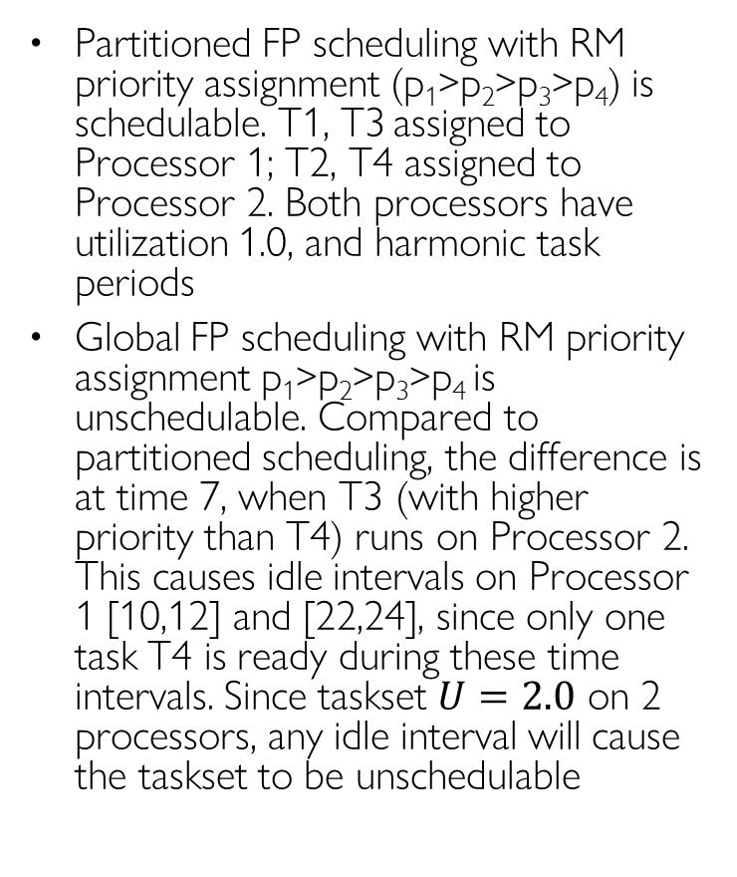
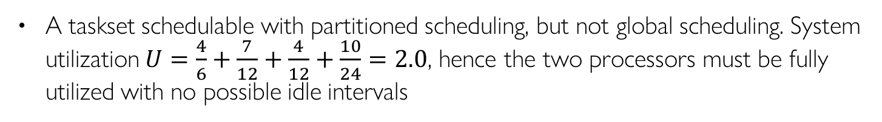
Global vs Partitioned (FP) Scheduling
Task | T=D | C | Prio
T1 | 6 | 4 | 4(H)
T2 | 12 | 7 | 3
T3 | 12 | 4 | 2
T4 | 24 | 10 | 1(L)
A taskset schedulable with partitioned scheduling, but not global scheduling. System utilization $U=\frac{4}{6}+\frac{7}{12}+\frac{4}{12}+\frac{10}{24}=2.0$, hence the two processors must be fully utilized with no possible idle intervals
At time 7, T4 runs on Processor 2
Partitioned FP scheduling with RM priority assignment (p₁>p₂>p₃>p₄) is schedulable. T1, T3 assigned to Processor 1; T2, T4 assigned to Processor 2. Both processors have utilization 1.0, and harmonic task periods
Global FP scheduling with RM priority assignment p₁>p₂>p₃>p₄ is unschedulable. Compared to partitioned scheduling, the difference is at time 7, when T3 (with higher priority than T4) runs on Processor 2. This causes idle intervals on Processor 1 [10,12] and [22,24], since only one task T4 is ready during these time intervals. Since taskset $U=2.0$ on 2 processors, any idle interval will cause the taskset to be unschedulable
A feasible execution trace
under partitioned scheduling
At time 7, T3 runs on Processor 2
Idle
Idle
An infeasible execution trace
under global scheduling
Notes:
4/6+7/12+4/12+10/24=
Not feasible for global scheduling: U=2.0 on 2 processors leaves no slack, so any idle interval makes the taskset unschedulable.
Partitioned scheduling is feasible
Four tasks τ₁=(4,6); τ₂=(7,12); τ₃=(4,12); τ₄=(10,24)

Slide 21
Difficulties of Global Scheduling
Dhall’s effect
  With RM, DM and EDF, some low-utilization task sets can be unschedulable regardless of how many processors are used.
Scheduling anomalies
  Decreasing task execution time or increasing task period may cause deadline misses
Hard-to-find worst-case
  The worst-case does not always occur when a task arrives at the same time as all its higher-priority tasks
Dependence on relative priority ordering (omitted)
  Changing the relative priority ordering among higher-priority tasks may affect schedulability for a lower-priority task
Notes:
A critical instant does not always occur when a task arrives at the same time as all its higher-priority tasks.

Slide 22
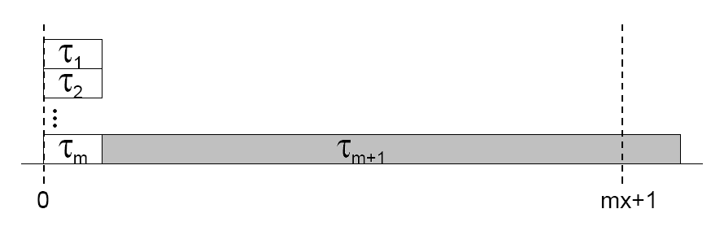
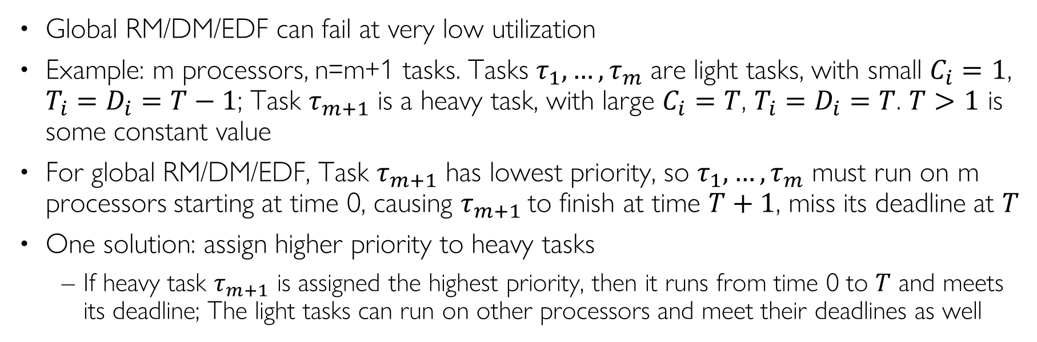
Dhall’s effect
Global RM/DM/EDF can fail at very low utilization
Example: m processors, n=m+1 tasks. Tasks $τ_{1}, …, τ_{m}$ are light tasks, with small $C_{i}=1$, $T_{i}=D_{i}=T−1$; Task $τ_{m+1}$ is a heavy task, with large $C_{i}=T$, $T_{i}=D_{i}=T$. $T≥2$ is some constant value
For global RM/DM/EDF, Task $τ_{m+1}$ has lowest priority, so $τ_{1}, …, τ_{m}$ must run on m processors starting at time 0, causing $τ_{m+1}$to finish at time $T+1$, miss its deadline at $T$
One solution: assign higher priority to heavy tasks
  If heavy task $τ_{m+1}$ is assigned the highest priority, then it runs from time 0 to $T$ and meets its deadline; The light tasks can run on other processors and meet their deadlines as well
m light tasks
1 heavy task
U_{tot}→1
Deadline
Miss
T
Notes:
Dhall’s effect: m light tasks (C=1, T=D=T-1) and one heavy task (C=T, T=D=T). The light tasks run first on all m processors during [0,1], so the heavy task can start only at t=1 and finishes at T+1, missing its deadline T, although total utilization m/(T-1)+1 approaches 1 for large T (about 1/m of the m-processor capacity).

Slide 23
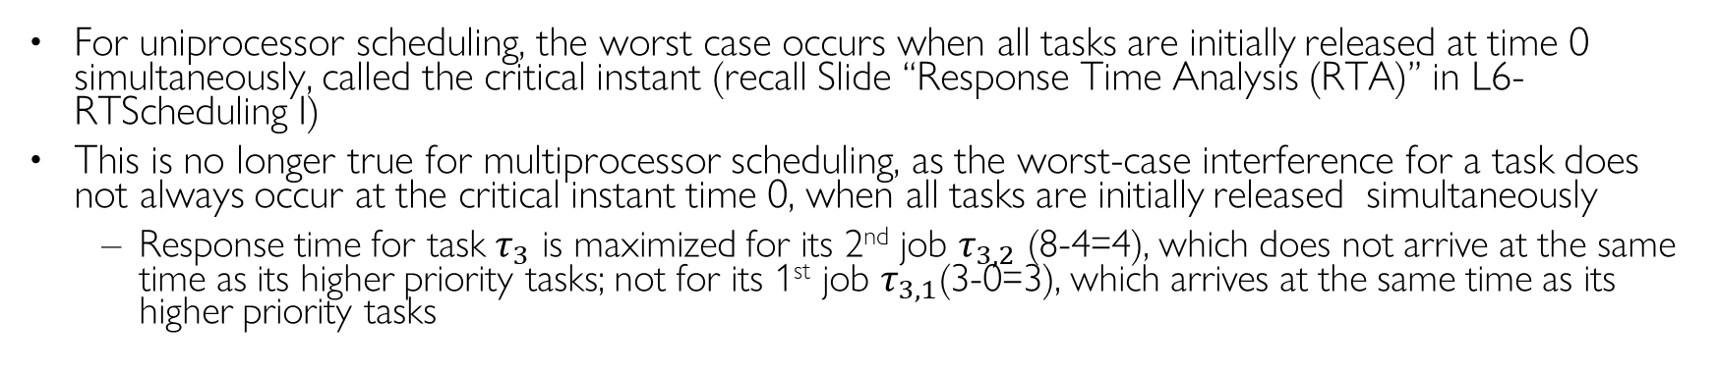
Hard-to-Find Worst-Case
For uniprocessor scheduling, the worst case occurs when all tasks are initially released at time 0 simultaneously, called the critical instant (recall Slide “Response Time Analysis (RTA)” in L6-RTScheduling I)
This is no longer true for multiprocessor scheduling, as the worst-case interference for a task does not always occur at the critical instant time 0, when all tasks are initially released simultaneously
  Response time for task $τ_{3}$ is maximized for its 2nd job $τ_{3,2}$ (8-4=4), which does not arrive at the same time as its higher priority tasks; not for its 1st job $τ_{3,1}$(3-0=3), which arrives at the same time as its higher priority tasks
Notes:
Recall that knowledge about the critical instant is a fundamental property of uniprocessor schedulability analysis (e.g., RTA).
A critical instant does not always occur when a task arrives at the same time as all its higher-priority tasks.
For uniprocessor scheduling, the worst case for a task occurs at time 0, when it arrives at the same time as all its higher-priority tasks.

Slide 24
MP Scheduling Anomalies
Decrease in processor demand (decreasing task execution time or increasing task period) may cause deadline misses!
Anomaly 1
  Decrease in processor demand from higher-priority tasks can increase the interference on a lower-priority task because of change in the time when the tasks execute
Anomaly 2
  Decrease in processor demand of a task negatively affects the task itself because change in the task arrival times cause it to suffer more interference
Notes:
EDF does not suffer from execution-time anomalies, but does suffer from period anomalies.

Slide 25
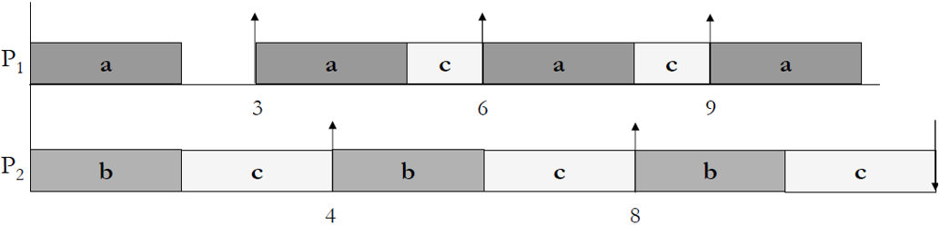
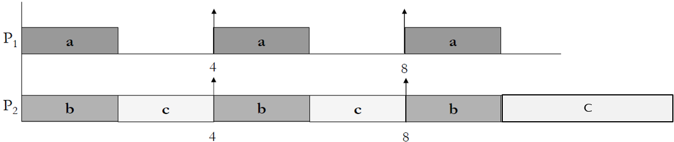
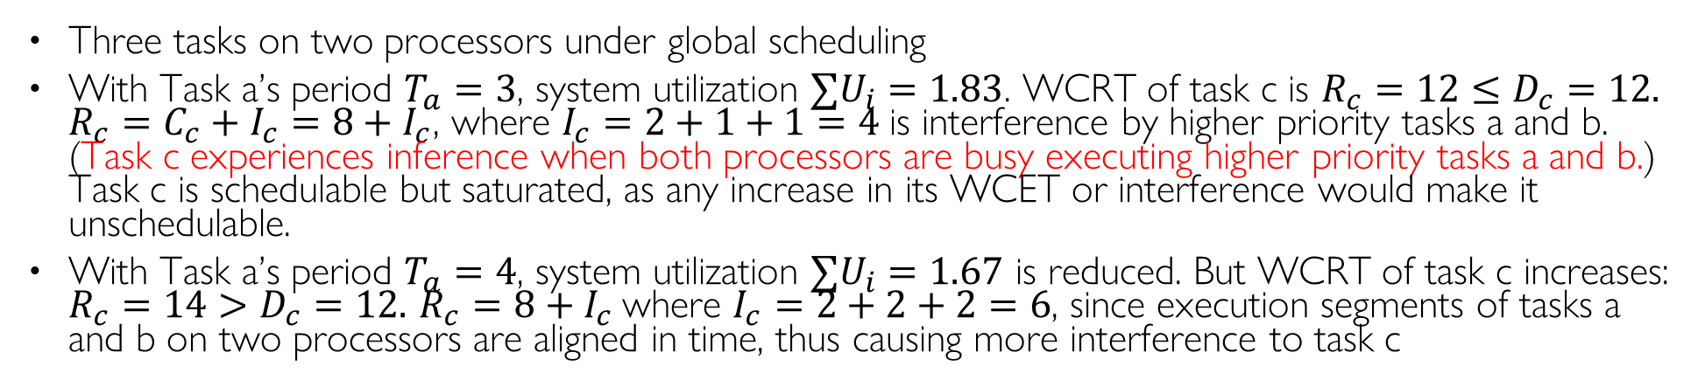
Scheduling Anomaly Example 1
Three tasks on two processors under global scheduling
With Task a’s period $T_{a}=3$, system utilization $∑U_{i}=1.83$. WCRT of task c is $R_{c}=12≤D_{c}=12.$ $R_{c}=C_{c}+I_{c}=8+I_{c}$, where $I_{c}=2+1+1=4$is interference by higher priority tasks a and b. (Task c experiences interference when both processors are busy executing higher priority tasks a and b.) Task c is schedulable but saturated, as any increase in its WCET or interference would make it unschedulable.
With Task a’s period $T_{a}=4$, system utilization $∑U_{i}=1.67$ is reduced. But WCRT of task c increases: $R_{c}=14>D_{c}=12.$ $R_{c}=8+I_{c}$where $I_{c}=2+2+2=6$, since execution segments of tasks a and b on two processors are aligned in time, thus causing more interference to task c
Task c deadline
at 12
Task | T=D | C | Util | Prio
a | 3 | 2 | 0.67 | H
b | 4 | 2 | 0.5 | M
c | 12 | 8 | 0.67 | L
Interference of 2
Interference of 1
Interference of 1
0
12
Task | T=D | C | Util | Prio
a | 4 | 2 | 0.5 | H
b | 4 | 2 | 0.5 | M
c | 12 | 8 | 0.67 | L
Task c deadline
at 12
Interference of 2
Interference of 2
Interference of 2
0
14

Slide 26
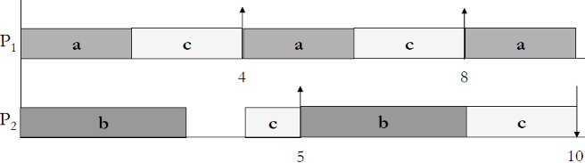
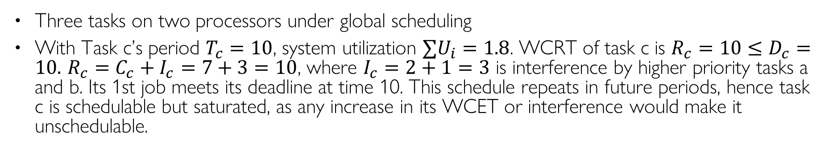
Scheduling Anomaly Example 2
Three tasks on two processors under global scheduling
With Task c’s period $T_{c}=10$, system utilization $∑U_{i}=1.8$. WCRT of task c is $R_{c}=10≤D_{c}=10.$ $R_{c}=C_{c}+I_{c}=7+3=10$, where $I_{c}=2+1=3$ is interference by higher priority tasks a and b. Its 1st job meets its deadline at time 10. This schedule repeats in future periods, hence task c is schedulable but saturated, as any increase in its WCET or interference would make it unschedulable.
Task c’s 1st job’s deadline at 10
Task | T=D | C | Util | Prio
a | 4 | 2 | 0.5 | H
b | 5 | 3 | 0.6 | M
c | 10 | 7 | 0.7 | L
Interference of 2
Interference of 1
Notes:
Two processors and total task utilization $∑U_{i}=1.8$

Slide 27
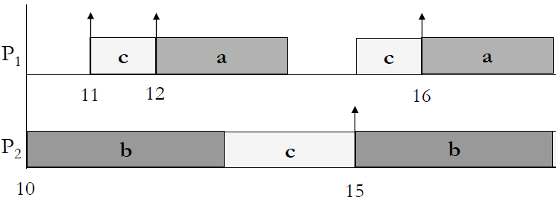
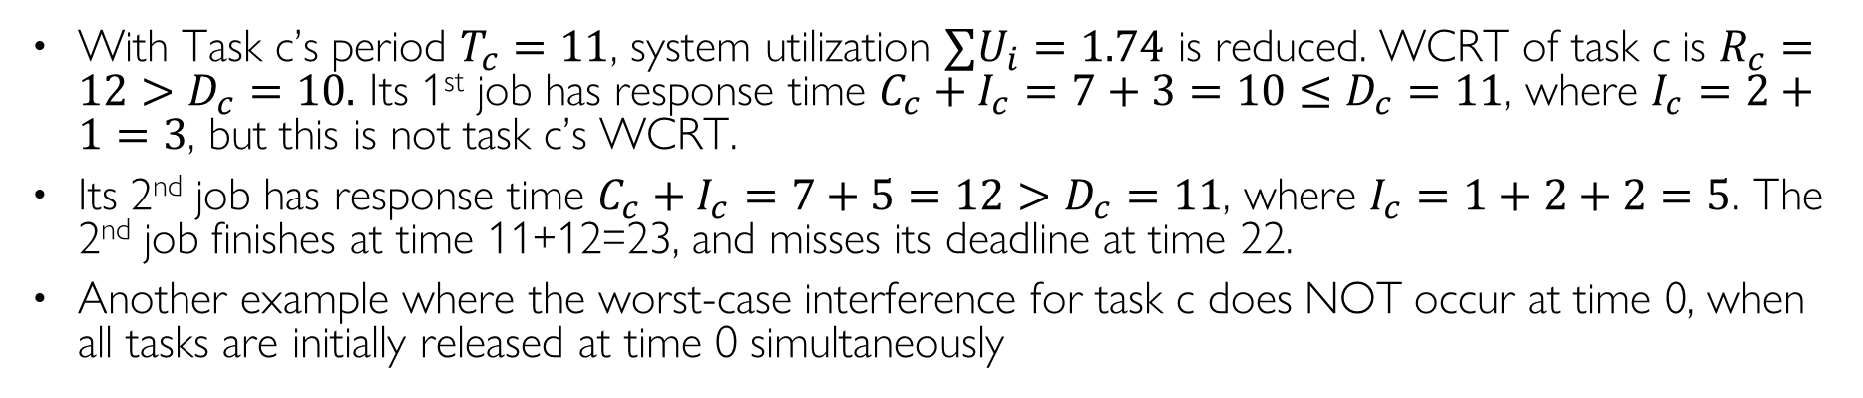
Scheduling Anomaly Example 2
With Task c’s period $T_{c}=11$, system utilization $∑U_{i}=1.74$ is reduced. WCRT of task c is $R_{c}=12>D_{c}=11.$ Its 1st job has response time $C_{c}+I_{c}=7+3=10≤D_{c}=11$, where $I_{c}=2+1=3$, but this is not task c’s WCRT.
Its 2nd job has response time $C_{c}+I_{c}=7+5=12>D_{c}=11$, where $I_{c}=1+2+2=5$. The 2nd job finishes at time 11+12=23, and misses its deadline at time 22.
Another example where the worst-case interference for task c does NOT occur at time 0, when all tasks are initially released at time 0 simultaneously
Task | T=D | C | Util | Prio
a | 4 | 2 | 0.5 | H
b | 5 | 3 | 0.6 | M
c | 11 | 7 | 0.64 | L
Interference of 2
Interference of 1
0
a
c
Interference of 1
Interference of 2
Interference of 2
c
b
20
23
Task c’s 1st job’s deadline at 11
Task c’s 2nd job’s deadline at 22
Notes:
For uniprocessor scheduling, the worst-case response time of a task occurs at the critical instant, when it arrives at the same time as all its higher-priority tasks. This does not hold on multiprocessors: here task c’s WCRT (12) occurs for its 2nd job (released at time 11), not for its 1st job (response time 10).

Slide 28
Resource Synchronization Protocols
(for Fixed-Priority Scheduling)

Slide 29








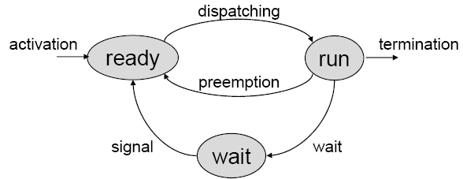
Resource Sharing
When two tasks access shared resources (variables), mutexes (or binary semaphores) are used to protect critical sections. Each Critical Section (CS) must begin with lock(s) and end with unlock(s)
A task waiting for a shared resource is blocked on that resource. Otherwise, it proceeds by entering the critical section and holds the resource
Tasks blocked on the same resource are kept in a queue. When a running task invokes lock(s) when s is already locked, it enters the waiting state, until another task unlocks s
Shared resources
(shared variables)
lock(s)
x = 3;
y = 5;
unlock(s)
lock(s)
a = x+1;
b = y+2;
c = x+y;
unlock(s)
write
int x;
int y;
read
Notes:
Some shared resources do not allow simultaneous accesses but require mutual exclusion. A piece of code executed under mutual exclusion constraints is called a critical section.
When a task leaves a critical section, the associated resource becomes free.
Examples of common resources: data structures, variables, main memory area, file, set of registers, I/O unit, … .
Each shared resource R_{i} must be protected by a semaphore S_{i}, and
Many shared resources do not allow simultaneous accesses but require mutual exclusion (exclusive resources). A piece of code executed under mutual exclusion constraints is called a critical section.
A task waiting for an exclusive resource is said to be blocked on that resource. Otherwise, it proceeds by entering the critical section and holds the resource. When a task leaves a critical section, the associated resource becomes free.
Waiting state caused by resource constraints:

Slide 30


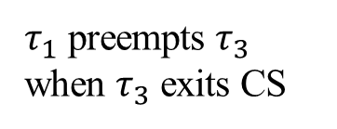
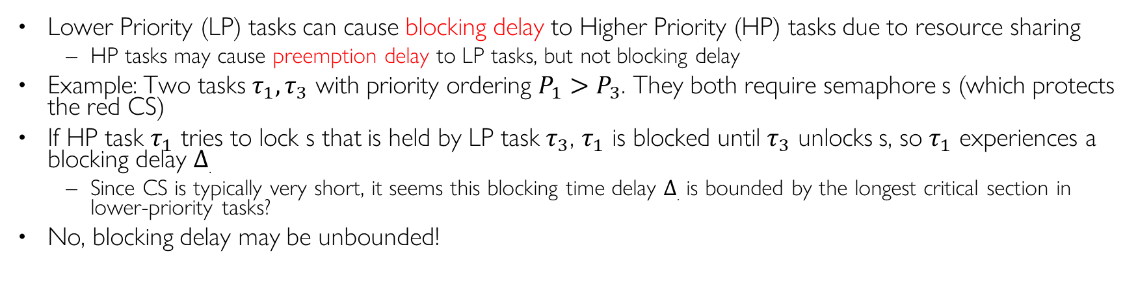




Blocking Delay
Lower Priority (LP) tasks can cause blocking delay to Higher Priority (HP) tasks due to resource sharing
  HP tasks may cause preemption delay to LP tasks, but not blocking delay
Example: Two tasks $τ_{1}, τ_{3}$ with priority ordering $P_{1}>P_{3}$. They both require semaphore s (which protects the red CS)
If HP task $τ_{1}$ tries to lock s that is held by LP task $τ_{3}$, $τ_{1}$ is blocked until $τ_{3}$ unlocks s, so $τ_{1}$ experiences a blocking delay $Δ$.
  Since CS is typically very short, it seems this blocking time delay $Δ$. is bounded by the longest critical section in lower-priority tasks?
No, blocking delay may be unbounded!
Blocking Delay $Δ$ (short, bounded)
priority
$$d_{1}$$
$τ_{1}$
$τ_{1}$ preempts $τ_{3}$
$τ_{3}$ blocks $τ_{1}$
$τ_{1}$ preempts $τ_{3}$ when $τ_{3}$ exits CS
$τ_{3}$
0
2
3
4
6
8
10
12
14
16
18

Slide 31




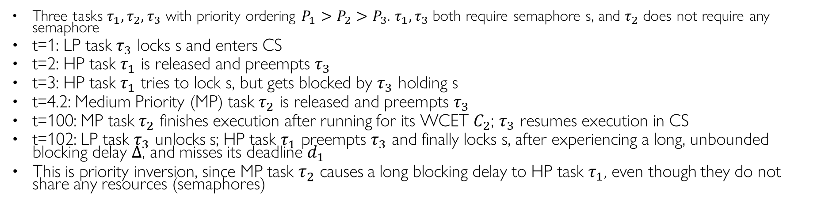



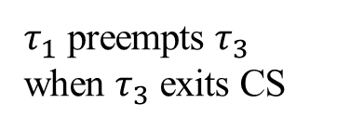



Priority Inversion I
Three tasks $τ_{1}, τ_{2}, τ_{3}$ with priority ordering $P_{1}>P_{2}>P_{3}$. $τ_{1}, τ_{3}$ both require semaphore s, and $τ_{2}$ does not require any semaphore
t=1: LP task $τ_{3}$ locks s and enters CS
t=2: HP task $τ_{1}$ is released and preempts $τ_{3}$
t=3: HP task $τ_{1}$ tries to lock s, but gets blocked by $τ_{3}$ holding s
t=4.2: Medium Priority (MP) task $τ_{2}$ is released and preempts $τ_{3}$
t=100: MP task $τ_{2}$ finishes execution after running for its WCET $C_{2}$; $τ_{3}$ resumes execution in CS
t=102: LP task $τ_{3}$ unlocks s; HP task $τ_{1}$ preempts $τ_{3}$ and finally locks s, after experiencing a long, unbounded blocking delay $Δ$, and misses its deadline $d_{1}$
This is priority inversion, since MP task $τ_{2}$ causes a long blocking delay to HP task $τ_{1},$ even though they do not share any resources (semaphores)
Blocking Delay $Δ$ (long, unbounded)
priority
$$d_{1}$$
$τ_{1}$
$τ_{1}$ preempts $τ_{3}$
$τ_{3}$ blocks $τ_{1}$
$τ_{1}$ preempts $τ_{3}$ when $τ_{3}$ exits CS
WCET $C_{2}$ of $τ_{2}$
$τ_{2}$
$τ_{2}$ preempts $τ_{3}$
$τ_{2}$ finishes
$τ_{3}$
0
2
4
6
100
102
104
106
108
Notes:
When tasks share resources, there may be priority inversions. t=3: MP task B is invoked, but cannot start running due to HP task A running
Three tasks $τ_{1}, τ_{2}, τ_{3}$ with priority ordering $P_{1}>P_{2}>P_{3}$. $τ_{1}, τ_{2}$ both require semaphore s, and $τ_{3}$ does not require any semaphore
Example

Slide 32



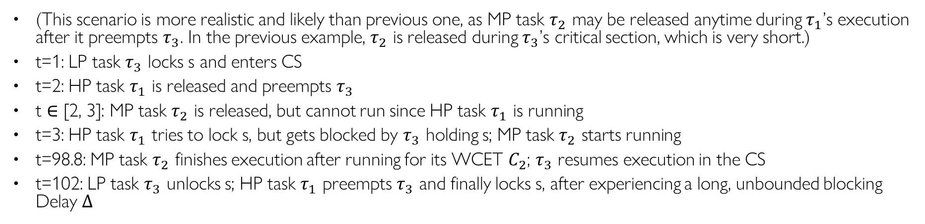

Priority Inversion II
(This scenario is more realistic and likely than previous one, as MP task $τ_{2}$ may be released anytime during $τ_{1}$’s execution after it preempts $τ_{3}$. In the previous example, $τ_{2}$ is released during $τ_{3}$’s critical section, which is very short.)
t=1: LP task $τ_{3}$ locks s and enters CS
t=2: HP task $τ_{1}$ is released and preempts $τ_{3}$
t $∈$ [2, 3]: MP task $τ_{2}$ is released, but cannot run since HP task $τ_{1}$ is running
t=3: HP task $τ_{1}$ tries to lock s, but gets blocked by $τ_{3}$ holding s; MP task $τ_{2}$ starts running
t=98.8: MP task $τ_{2}$ finishes execution after running for its WCET $C_{2}$; $τ_{3}$ resumes execution in the CS
t=102: LP task $τ_{3}$ unlocks s; HP task $τ_{1}$ preempts $τ_{3}$ and finally locks s, after experiencing a long, unbounded blocking Delay $Δ$
Blocking Delay $Δ$ (long, unbounded)
priority
$$d_{1}$$
$τ_{1}$
$τ_{1}$ preempts $τ_{3}$
$τ_{2}$ preempts $τ_{3}$
$τ_{1}$ preempts $τ_{3}$ when $τ_{3}$ exits CS
$τ_{2}$
$τ_{2}$ released
$τ_{2}$ finishes
$τ_{3}$
0
2
4
6
100
102
104
106
108
Notes:
When tasks share resources, there may be priority inversions. t=3: MP task B is invoked, but cannot start running due to HP task A running
Example

Slide 33
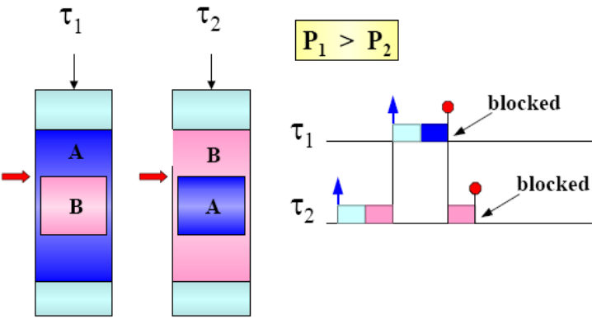
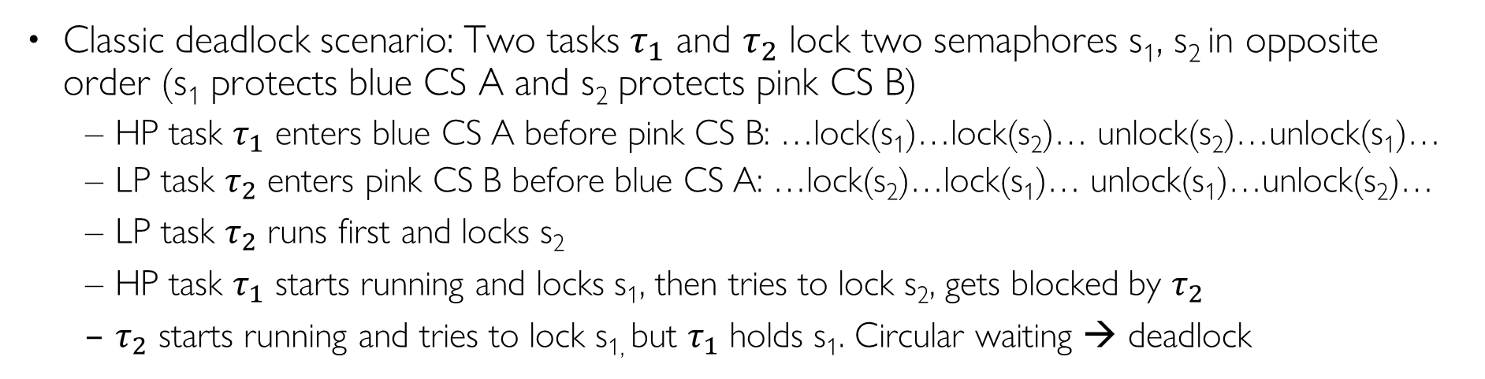
Deadlocks
Classic deadlock scenario: Two tasks $τ_{1}$ and $τ_{2}$ lock two semaphores s₁, s₂ in opposite order (s₁ protects blue CS A and s₂ protects pink CS B)
  HP task $τ_{1}$ enters blue CS A before pink CS B: …lock(s₁)…lock(s₂)… unlock(s₂)…unlock(s₁)…
  LP task $τ_{2}$ enters pink CS B before blue CS A: …lock(s₂)…lock(s₁)… unlock(s₁)…unlock(s₂)…
  LP task $τ_{2}$ runs first and locks s₂
  HP task $τ_{1}$ starts running and locks s₁, then tries to lock s₂, gets blocked by $τ_{2}$
  $τ_{2}$ starts running and tries to lock s_{1,} but $τ_{1}$ holds s₁. Circular waiting → deadlock
s₁
s₂
s₂
s₁
Notes:
<
HP task $τ_{1}$ enters blue CS A before pink CS B, by calling wait(s₁); wait(s₂); signal(s₂); signal(s₁)
LP task $τ_{1}$ enters pink CS B before blue CS A, by calling wait(s₂); wait(s₁); signal(s₁); signal(s₂)
Tasks must lock semaphores in a “pyramid” fashion
If we have two semaphores s₁ and s₂, then using PCP, this is a legal trace:
lock(s₁)…lock(s₂)…unlock(s₂)…unlock(s₁)
This is an illegal trace:
lock(s₁)…lock(s₂)…unlock(s₁)…unlock(s₂)

Slide 34




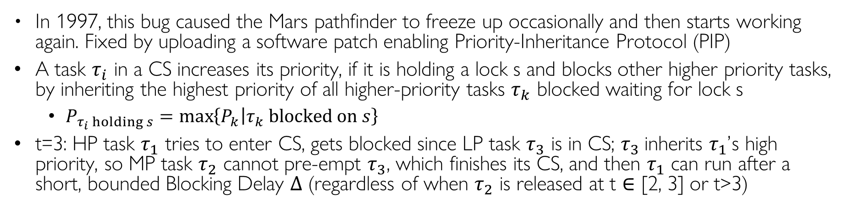

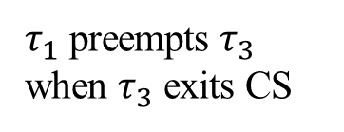


Priority Inheritance Protocol (PIP)
In 1997, this bug caused the Mars pathfinder to freeze up occasionally and then start working again. Fixed by uploading a software patch enabling Priority-Inheritance Protocol (PIP)
A task $τ_{i}$ in a CS increases its priority, if it is holding a lock s and blocks other higher priority tasks, by inheriting the highest priority of all higher-priority tasks $τ_{k}$ blocked waiting for lock s
  $P_{τ_{i} holding s}=\max\left\{P_{k} | τ_{k} blocked on s\right\}$
t=3: HP task $τ_{1}$ tries to enter CS, gets blocked since LP task $τ_{3}$ is in CS; $τ_{3}$inherits $τ_{1}$’s high priority, so MP task $τ_{2}$ cannot preempt $τ_{3}$, which finishes its CS, and then $τ_{1}$ can run after a short, bounded Blocking Delay $Δ$ (regardless of when $τ_{2}$ is released at t $∈$ [2, 3] or t>3)
Blocking Delay $Δ$ (short, bounded)
priority
$$d_{1}$$
$τ_{1}$
$τ_{1}$ preempts $τ_{3}$
$τ_{3}$ blocks $τ_{1}$
$τ_{1}$ preempts $τ_{3}$ when $τ_{3}$ exits CS
$τ_{2}$
$τ_{3}$
$τ_{3}$runs at $τ_{1}$’s priority
0
2
4
6
8
10
12
14
16
18
Notes:
when $τ_{i}$ is blocked on $s_{k}$, the lower-priority task currently holding $s_{k}$ inherits $τ_{i}$’s priority
In 1997, this bug caused the Mars pathfinder to freeze up occasionally without explanation, and then starts working again
Fixed by uploading a software patch enabling Priority-Inheritance Protocol (PIP)
PIP: A task in a CS increases its priority if it is holding a lock s, and blocks other higher priority tasks, by inheriting the highest priority of all tasks blocked waiting for lock s
$P_{CS}=\max{\{P_{k}|τ_{k} blocked on CS\}}$
When a task locks a semaphore, it inherits the highest priority of all tasks blocked waiting for the semaphore
We consider two Resource Access Protocols that can prevent priority inversions and/or deadlocks.
Priority Inheritance Protocol
Priority Ceiling Protocol
When a task locks a semaphore, it inherits the highest priority of all tasks blocked waiting for the semaphore
•A task in a CS increases its priority if it blocks other higher priority tasks, by inheriting the highest priority among those tasks it blocks
Scheduling Rule: Ready jobs are scheduled on the processor preemptively in a priority-driven manner according to their current priorities. At its release time t, the current priority of every job is equal to its assigned priority. The job remains at this priority except under the condition stated in rule 3.
Allocation Rule: When a job J requests a resource R at time t,
if R is free, R is allocated to J until J releases it, and
if R is not free, the request is denied and J is blocked.
Priority-inheritance Rule: When the requesting job J becomes blocked, the job J_{l} that blocks J inherits the current priority of J. The job J_{l} executes at its inherited priority until it releases R (or until it inherits an even higher priority); the priority of J_{l} returns to its priority π_{l}(t′) at the time t′ when it acquired the resource R.

Slide 35
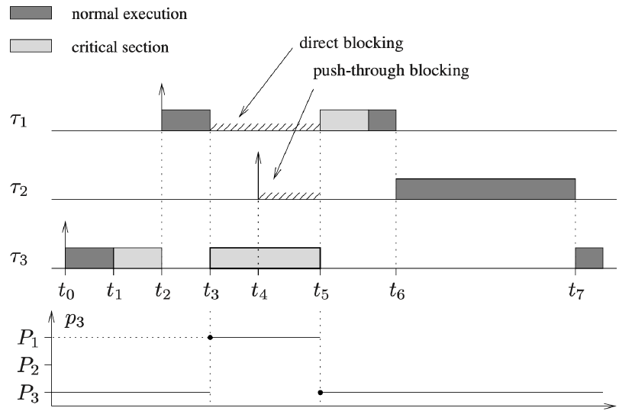
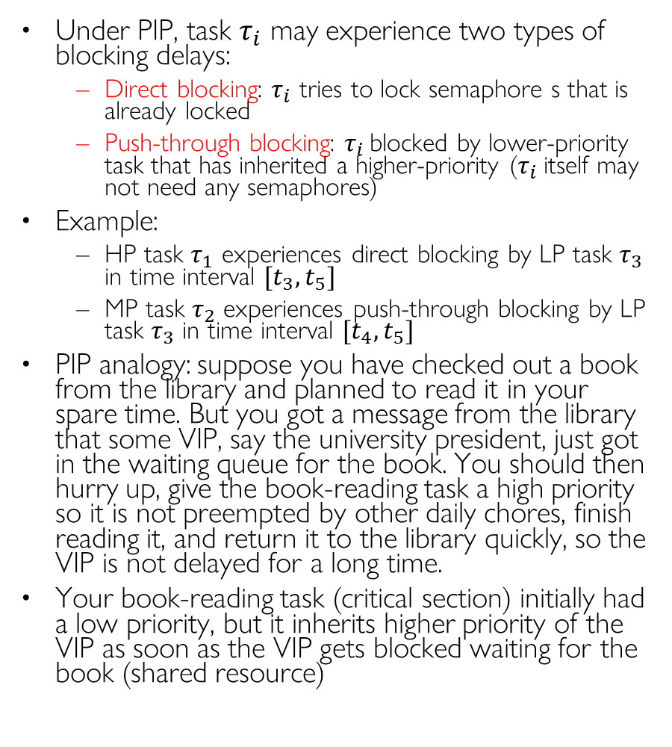
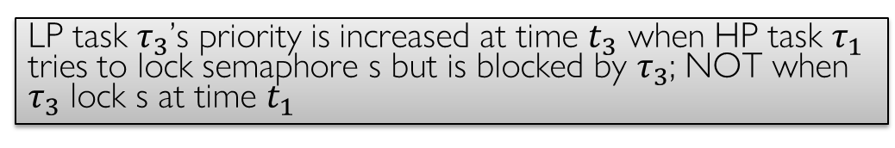
Blocking Time under PIP
Under PIP, task $τ_{i}$ may experience two types of blocking delays:
  Direct blocking: $τ_{i}$ tries to lock semaphore s that is already locked
  Push-through blocking: $τ_{i}$ blocked by lower-priority task that has inherited a higher-priority ($τ_{i}$itself may not need any semaphores)
Example:
  HP task $τ_{1}$ experiences direct blocking by LP task $τ_{3}$ in time interval $[t_{3}, t_{5}]$
  MP task $τ_{2}$ experiences push-through blocking by LP task $τ_{3}$ in time interval $[t_{4}, t_{5}]$
PIP analogy: suppose you have checked out a book from the library and planned to read it in your spare time. But you got a message from the library that some VIP, say the university president, just got in the waiting queue for the book. You should then hurry up, give the book-reading task a high priority so it is not preempted by other daily chores, finish reading it, and return it to the library quickly, so the VIP is not delayed for a long time.
Your book-reading task (critical section) initially had a low priority, but it inherits higher priority of the VIP as soon as the VIP gets blocked waiting for the book (shared resource)
LP task $τ_{3}$’s priority is increased at time $t_{3}$ when HP task $τ_{1}$ tries to lock semaphore s but is blocked by $τ_{3}$; NOT when $τ_{3}$ lock s at time $t_{1}$

Slide 36
PIP Pros and Cons
Pros:
  It prevents unbounded priority inversion
  It is transparent to the programmer
Cons:
  It does not prevent deadlocks and chained blocking
Deadlock still occurs under PIP
Notes:
Chained blocking:
Theorem: task $τ_{i}$ can be blocked at most once by each lower priority task
If n is the number of lower-priority tasks than $τ_{i}$, and m is the number of semaphores on which $τ_{i}$ can be blocked, then
Theorem: $τ_{i}$ can be blocked at most for the duration of min(n, m) critical sections
Priority Ceiling Protocol is a more advanced protocol, which prevents deadlocks and reduces blocking time

Slide 37

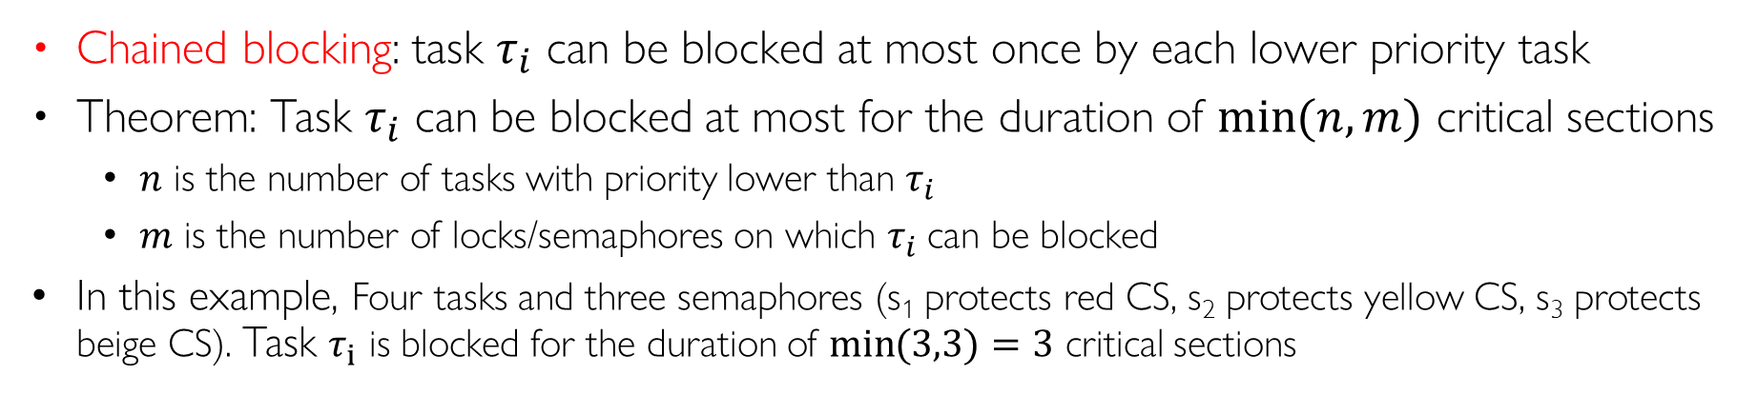
PIP Causes Chained Blocking
Chained blocking: task $τ_{i}$ can be blocked at most once by each lower priority task
Theorem: Task $τ_{i}$ can be blocked at most for the duration of $\min{(n,m)}$ critical sections
  $n$ is the number of tasks with priority lower than $τ_{i}$
  $m$ is the number of locks/semaphores on which $τ_{i}$can be blocked
In this example, Four tasks and three semaphores (s₁ protects red CS, s₂ protects yellow CS, s₃ protects beige CS). Task $τ_{1}$ is blocked for the duration of $\min{(3,3)}=3$ critical sections
priority
B₁ B₂ B₃
τ₁
τ₂
τ₃
τ₄

Slide 38
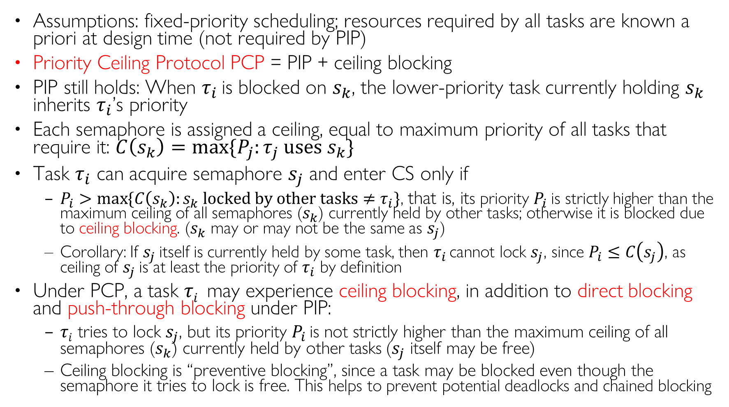
Priority Ceiling Protocol (PCP)
Assumptions: fixed-priority scheduling; resources required by all tasks are known a priori at design time (not required by PIP)
Priority Ceiling Protocol PCP = PIP + ceiling blocking
PIP still holds: When $τ_{i}$ is blocked on $s_{k}$, the lower-priority task currently holding $s_{k}$ inherits $τ_{i}$’s priority
Each semaphore is assigned a ceiling, equal to maximum priority of all tasks that require it: $C\left(s_{k}\right)=\max{\{P_{j}:τ_{j} uses s_{k}\}}$
Task $τ_{i}$ can acquire semaphore $s_{j}$ and enter CS only if
  $P_{i}>\max{\{C\left(s_{k}\right):s_{k} locked by other tasks≠τ_{i}}\}$, that is, its priority $P_{i}$ is strictly higher than the maximum ceiling of all semaphores ($s_{k}$) currently held by other tasks; otherwise it is blocked due to ceiling blocking. ($s_{k}$ may or may not be the same as $s_{j}$)
  Corollary: If $s_{j}$ itself is currently held by some task, then $τ_{i}$ cannot lock $s_{j}$, since $P_{i}≤C\left(s_{j}\right)$, as ceiling of $s_{j}$ is at least the priority of $τ_{i}$ by definition
Under PCP, a task $τi$ may experience ceiling blocking, in addition to direct blocking and push-through blocking under PIP:
  $τi$ tries to lock $s_{j}$, but its priority $P_{i}$ is not strictly higher than the maximum ceiling of all semaphores ($s_{k}$) currently held by other tasks ($s_{j}$ itself may be free)
  Ceiling blocking is “preventive blocking”, since a task may be blocked even though the semaphore it tries to lock is free. This helps to prevent potential deadlocks and chained blocking

Slide 39

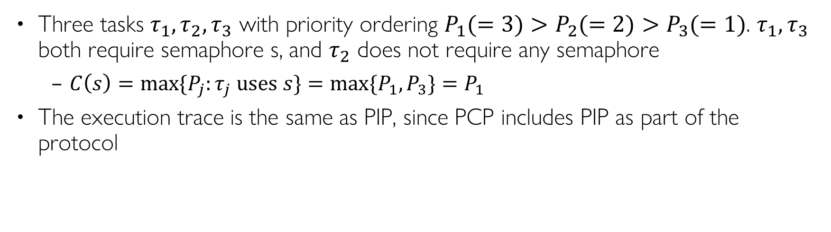



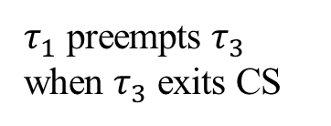




PCP Example I
Three tasks $τ_{1}, τ_{2}, τ_{3}$ with priority ordering $P_{1}(=3)>P_{2}(=2)>P_{3}(=1)$. $τ_{1}, τ_{3}$ both require semaphore s, and $τ_{2}$ does not require any semaphore
  $C\left(s\right)=\max{\{P_{j}:τ_{j} uses s\}}=\max{\{P_{1}, P_{3}\}}=P_{1}$
The execution trace is the same as PIP, since PCP includes PIP as part of the protocol
Blocking Delay $Δ$ (short, bounded)
priority
$$d_{1}$$
$τ_{1}$
$τ_{1}$ preempts $τ_{3}$
$τ_{3}$ blocks $τ_{1}$
$τ_{1}$ preempts $τ_{3}$ when $τ_{3}$ exits CS
$τ_{2}$
$τ_{3}$
$τ_{3}$runs at $τ_{1}$’s priority
0
2
4
6
8
10
12
14
16
18
Notes:
when $τ_{i}$ is blocked on $s_{k}$, the lower-priority task currently holding $s_{k}$ inherits $τ_{i}$’s priority
When τ₃ is holding s, τ₁ cannot lock s, since $P_{1}≤C\left(s\right)=P_{1}$
Scheduling Rule: Ready jobs are scheduled on the processor preemptively in a priority-driven manner according to their current priorities. At its release time t, the current priority of every job is equal to its assigned priority. The job remains at this priority except under the condition stated in rule 3.
Allocation Rule: When a job J requests a resource R at time t,
if R is free, R is allocated to J until J releases it, and
if R is not free, the request is denied and J is blocked.
Priority-inheritance Rule: When the requesting job J becomes blocked, the job J_{l} that blocks J inherits the current priority of J. The job J_{l} executes at its inherited priority until it releases R (or until it inherits an even higher priority); the priority of J_{l} returns to its priority π_{l}(t′) at the time t′ when it acquired the resource R.

Slide 40
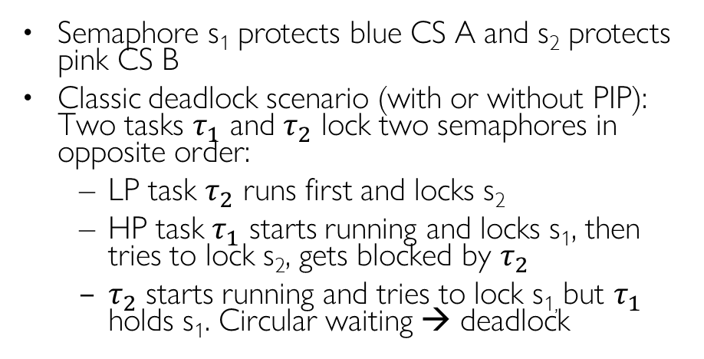
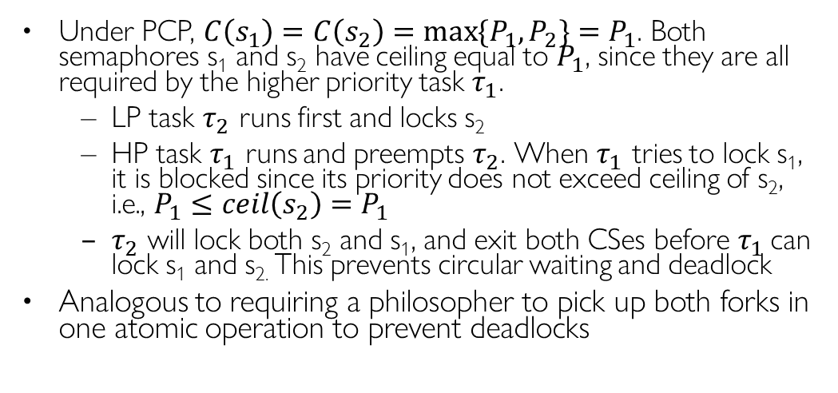
PCP Prevents Deadlocks
Semaphore s₁ protects blue CS A and s₂ protects pink CS B
Classic deadlock scenario (with or without PIP): Two tasks $τ_{1}$ and $τ_{2}$ lock two semaphores in opposite order:
  LP task $τ_{2}$ runs first and locks s₂
  HP task $τ_{1}$ starts running and locks s₁, then tries to lock s₂, gets blocked by $τ_{2}$
  $τ_{2}$ starts running and tries to lock s_{1,} but $τ_{1}$ holds s₁. Circular waiting → deadlock
Under PCP, $C\left(s_{1}\right)=C\left(s_{2}\right)=\max{\{P_{1}, P_{2}\}}=P_{1}$. Both semaphores s₁ and s₂ have ceiling equal to $P_{1}$, since they are all required by the higher priority task $τ_{1}$.
  LP task $τ_{2}$ runs first and locks s₂
  HP task $τ_{1}$ runs and preempts $τ_{2}$. When $τ_{1}$ tries to lock s₁, it is blocked since its priority does not exceed ceiling of s₂, i.e., $P_{1}≤ceil\left(s_{2}\right)=P_{1}$
  $τ_{2}$ will lock both s₂ and s₁, and exit both CSes before $τ_{1}$ can lock s₁ and s_{2.} This prevents circular waiting and deadlock
Analogous to requiring a philosopher to pick up both forks in one atomic operation to prevent deadlocks
Notes:
Let each philosopher pick up both left and right forks atomically within a critical section (L3, “Semaphore-based Solution I”)
When τ₂ is holding s₂ (in pink CS), when LP task $τ_{2}$ is holding $s_{1}$ (in pink CS), MP task $τ_{2}$ tries to lock $s_{2}$ and enter yellow CS, but it is blocked since $P_{2}≤C\left(s_{2}\right)=P_{1}$
τ₁ cannot lock s₁ and enter blue CS, since Deadlock avoidance:

Slide 41
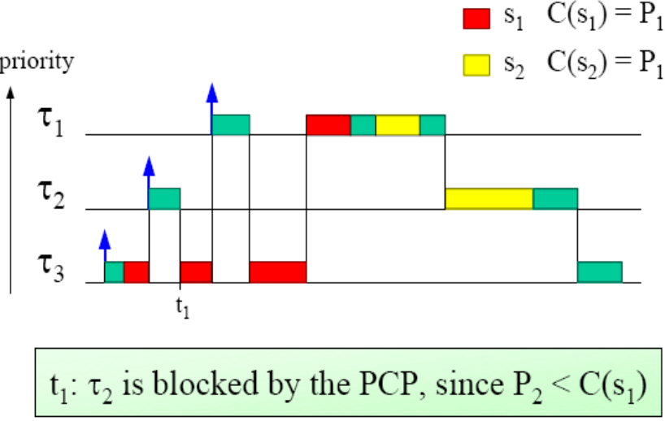
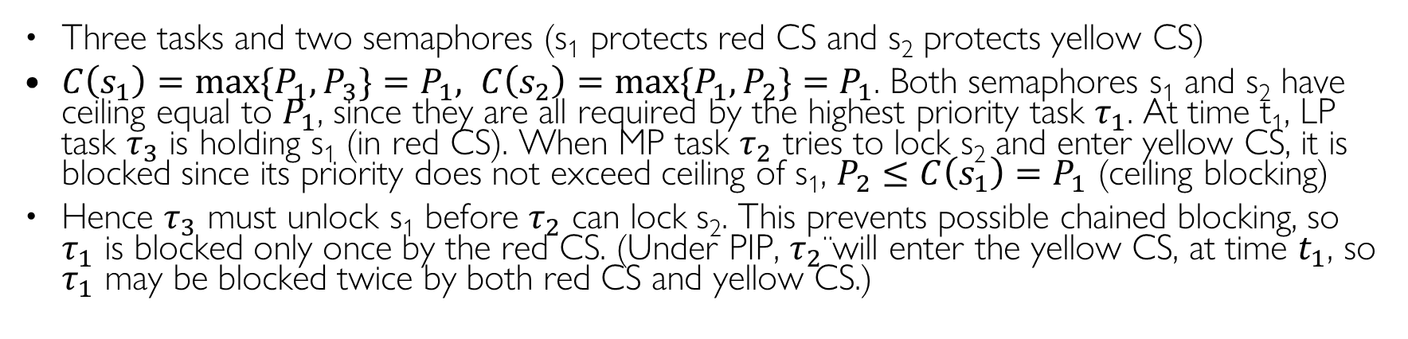
PCP Prevents Chained Blocking
Three tasks and two semaphores (s₁ protects red CS and s₂ protects yellow CS)
$C\left(s_{1}\right)=\max{\{P_{1}, P_{3}\}}=P_{1}, C\left(s_{2}\right)=\max{\{P_{1}, P_{2}\}}=P_{1}$. Both semaphores s₁ and s₂ have ceiling equal to $P_{1}$, since they are all required by the highest priority task $τ_{1}$. At time t₁, LP task $τ_{3}$ is holding s₁ (in red CS). When MP task $τ_{2}$ tries to lock s₂ and enter yellow CS, it is blocked since its priority does not exceed ceiling of s₁, $P_{2}≤C\left(s_{1}\right)=P_{1}$ (ceiling blocking)
Hence $τ_{3}$ must unlock s₁ before $τ_{2}$ can lock s₂. This prevents possible chained blocking, so $τ_{1}$ is blocked only once by the red CS. (Under PIP, $τ_{2}$ will enter the yellow CS, at time $t_{1}$, so $τ_{1}$ may be blocked twice by both red CS and yellow CS.)

Slide 42
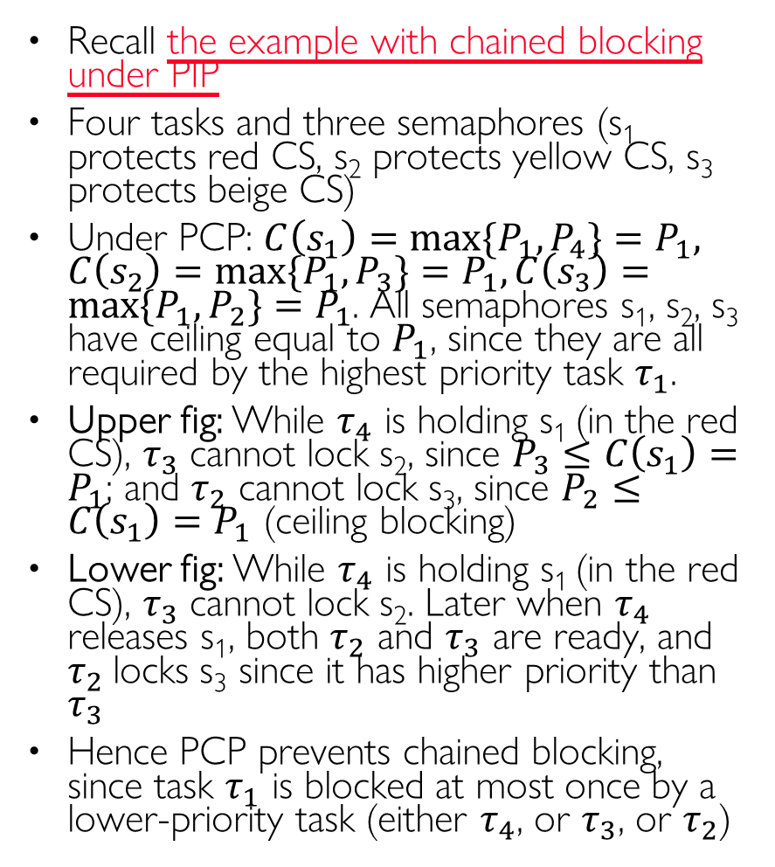
PCP Prevents Chained Blocking
Recall the example with chained blocking under PIP
Four tasks and three semaphores (s₁ protects red CS, s₂ protects yellow CS, s₃ protects beige CS)
Under PCP: $C\left(s_{1}\right)=\max{\{P_{1}, P_{4}\}}=P_{1}, C\left(s_{2}\right)=\max{\{P_{1}, P_{3}\}}=P_{1}, C\left(s_{3}\right)=\max{\{P_{1}, P_{2}\}}=P_{1}$. All semaphores s₁, s₂, s₃ have ceiling equal to $P_{1}$, since they are all required by the highest priority task $τ_{1}$.
Upper fig: While $τ_{4}$ is holding s₁ (in the red CS), $τ_{3}$ cannot lock s₂, since $P_{3}≤C\left(s_{1}\right)=P_{1}$; and $τ_{2}$ cannot lock s₃, since $P_{2}≤C\left(s_{1}\right)=P_{1}$ (ceiling blocking)
Lower fig: While $τ_{4}$ is holding s₁ (in the red CS), $τ_{3}$ cannot lock s₂. Later when $τ_{4}$ releases s₁, both $τ_{2}$ and $τ_{3}$ are ready, and $τ_{2}$locks s₃ since it has higher priority than $τ_{3}$
Hence PCP prevents chained blocking, since task $τ_{1}$ is blocked at most once by a lower-priority task (either $τ_{4}$, or $τ_{3}$, or $τ_{2}$)
priority
B
τ₁
τ₂
τ₃
τ₄
priority
B
τ₁
τ₂
τ₃
τ₄
Notes:
(which protect the red, yellow and beige CS, respectively)

Slide 43
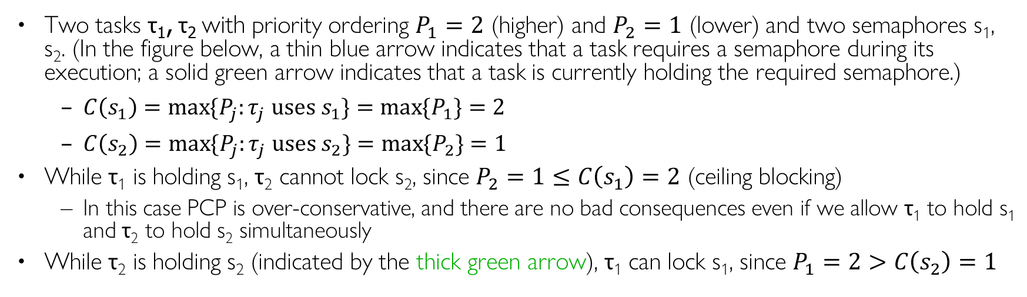
PCP Example II
Two tasks τ₁, τ₂ with priority ordering $P_{1}=2$ (higher) and $P_{2}=1$ (lower) and two semaphores s₁, s₂. (In the figure below, a thin blue arrow indicates that a task requires a semaphore during its execution; a solid green arrow indicates that a task is currently holding the required semaphore.)
  $C\left(s_{1}\right)=\max{\{P_{j}:τ_{j} uses s_{1}\}}=\max{\{P_{1}\}}=2$
  $C\left(s_{2}\right)=\max{\{P_{j}:τ_{j} uses s_{2}\}}=\max{\{P_{2}\}}=1$
While τ₁ is holding s₁, τ₂ cannot lock s₂, since $P_{2}=1≤C\left(s_{1}\right)=2$ (ceiling blocking)
  In this case PCP is over-conservative, and there are no bad consequences even if we allow τ₁ to hold s₁ and τ₂ to hold s₂ simultaneously
While τ₂ is holding s₂ (indicated by the thick green arrow), τ₁ can lock s₁, since $P_{1}=2>C\left(s_{2}\right)=1$
s₁
s₂
C(s₁)=2
C(s₂)=1
Task | Prio | sems
τ₁ | 2 | s₁
τ₂ | 1 | s₂
sem | Ceil
s₁ | 2
s₂ | 1
τ₁ (P₁=2)
τ₂ (P₂=1)

Slide 44
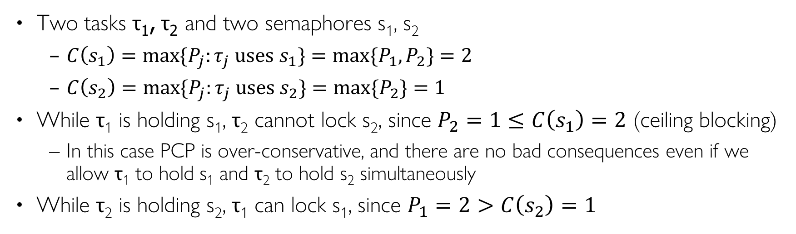
PCP Example II
Two tasks τ₁, τ₂ and two semaphores s₁, s₂
  $C\left(s_{1}\right)=\max{\{P_{j}:τ_{j} uses s_{1}\}}=\max{\{P_{1}, P_{2}\}}=2$
  $C\left(s_{2}\right)=\max{\{P_{j}:τ_{j} uses s_{2}\}}=\max{\{P_{2}\}}=1$
While τ₁ is holding s₁, τ₂ cannot lock s₂, since $P_{2}=1≤C\left(s_{1}\right)=2$ (ceiling blocking)
  In this case PCP is over-conservative, and there are no bad consequences even if we allow τ₁ to hold s₁ and τ₂ to hold s₂ simultaneously
While τ₂ is holding s₂, τ₁ can lock s₁, since $P_{1}=2>C\left(s_{2}\right)=1$
s₁
s₂
C(s₁)=2
C(s₂)=1
Task | Prio | sems
τ₁ | 2 | s₁
τ₂ | 1 | s₁, s₂
sem | Ceil
s₁ | 2
s₂ | 1
Not at the same time
τ₁ (P₁=2)
τ₂ (P₂=1)
Notes:
Ceiling blocking is “preventive blocking”, since $τ_{2}$ is blocked by $τ_{4}$, even though τ₂ tries to lock s₁ which is free. This prevents any potential deadlocks in the future, when τ₂, τ₄ each holds one of s₁, s₂ and tries to lock the other

Slide 45
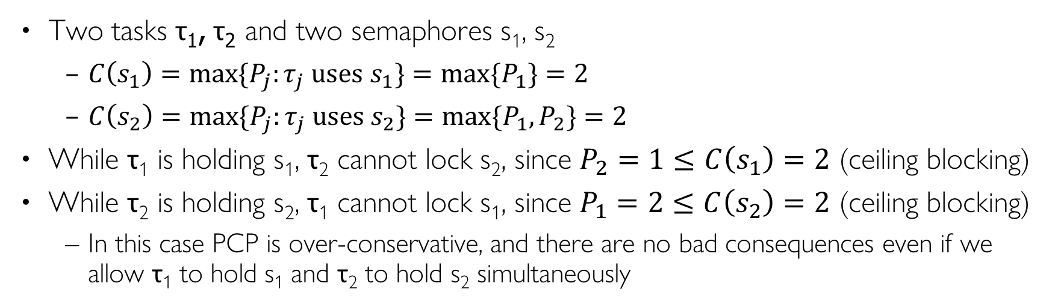
PCP Example II
Two tasks τ₁, τ₂ and two semaphores s₁, s₂
  $C\left(s_{1}\right)=\max{\{P_{j}:τ_{j} uses s_{1}\}}=\max{\{P_{1}\}}=2$
  $C\left(s_{2}\right)=\max{\{P_{j}:τ_{j} uses s_{2}\}}=\max{\{P_{1}, P_{2}\}}=2$
While τ₁ is holding s₁, τ₂ cannot lock s₂, since $P_{2}=1≤C\left(s_{1}\right)=2$ (ceiling blocking)
While τ₂ is holding s₂, τ₁ cannot lock s₁, since $P_{1}=2≤C\left(s_{2}\right)=2$ (ceiling blocking)
  In this case PCP is over-conservative, and there are no bad consequences even if we allow τ₁ to hold s₁ and τ₂ to hold s₂ simultaneously
s₁
s₂
C(s₁)=2
C(s₂)=2
Task | Prio | sems
τ₁ | 2 | s₁, s₂
τ₂ | 1 | s₂
sem | Ceil
s₁ | 2
s₂ | 2
τ₁ (P₁=2)
τ₂ (P₂=1)
Notes:
Ceiling blocking is “preventive blocking”, since $τ_{2}$ is blocked by $τ_{4}$, even though τ₂ tries to lock s₁ which is free. This prevents any potential deadlocks in the future, when τ₂, τ₄ each holds one of s₁, s₂ and tries to lock the other

Slide 46
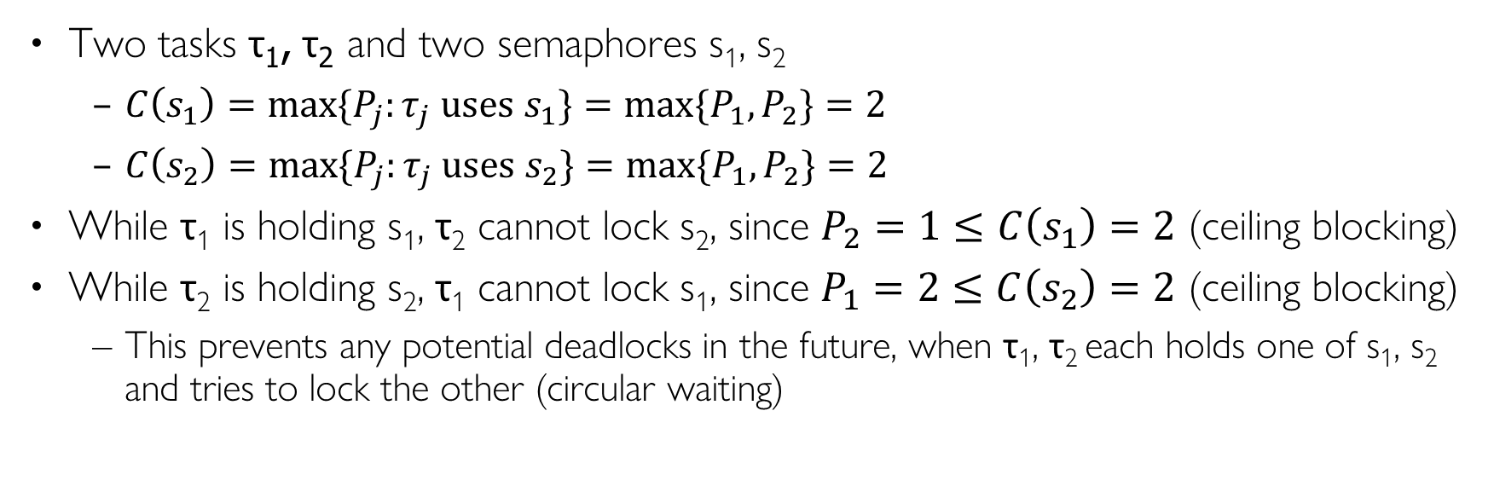
PCP Example II
Two tasks τ₁, τ₂ and two semaphores s₁, s₂
  $C\left(s_{1}\right)=\max{\{P_{j}:τ_{j} uses s_{1}\}}=\max{\{P_{1}, P_{2}\}}=2$
  $C\left(s_{2}\right)=\max{\{P_{j}:τ_{j} uses s_{2}\}}=\max{\{P_{1}, P_{2}\}}=2$
While τ₁ is holding s₁, τ₂ cannot lock s₂, since $P_{2}=1≤C\left(s_{1}\right)=2$ (ceiling blocking)
While τ₂ is holding s₂, τ₁ cannot lock s₁, since $P_{1}=2≤C\left(s_{2}\right)=2$ (ceiling blocking)
  This prevents any potential deadlocks in the future, when τ₁, τ₂ each holds one of s₁, s₂ and tries to lock the other (circular waiting)
s₁
s₂
C(s₁)=2
C(s₂)=2
Task | Prio | sems
τ₁ | 2 | s₁, s₂
τ₂ | 1 | s₁, s₂
sem | Ceil
s₁ | 2
s₂ | 2
τ₁ (P₁=2)
τ₂ (P₂=1)
Notes:
Ceiling blocking is “preventive blocking”, since $τ_{2}$ is blocked by $τ_{4}$, even though τ₂ tries to lock s₁ which is free. This prevents any potential deadlocks in the future, when τ₂, τ₄ each holds one of s₁, s₂ and tries to lock the other

Slide 47
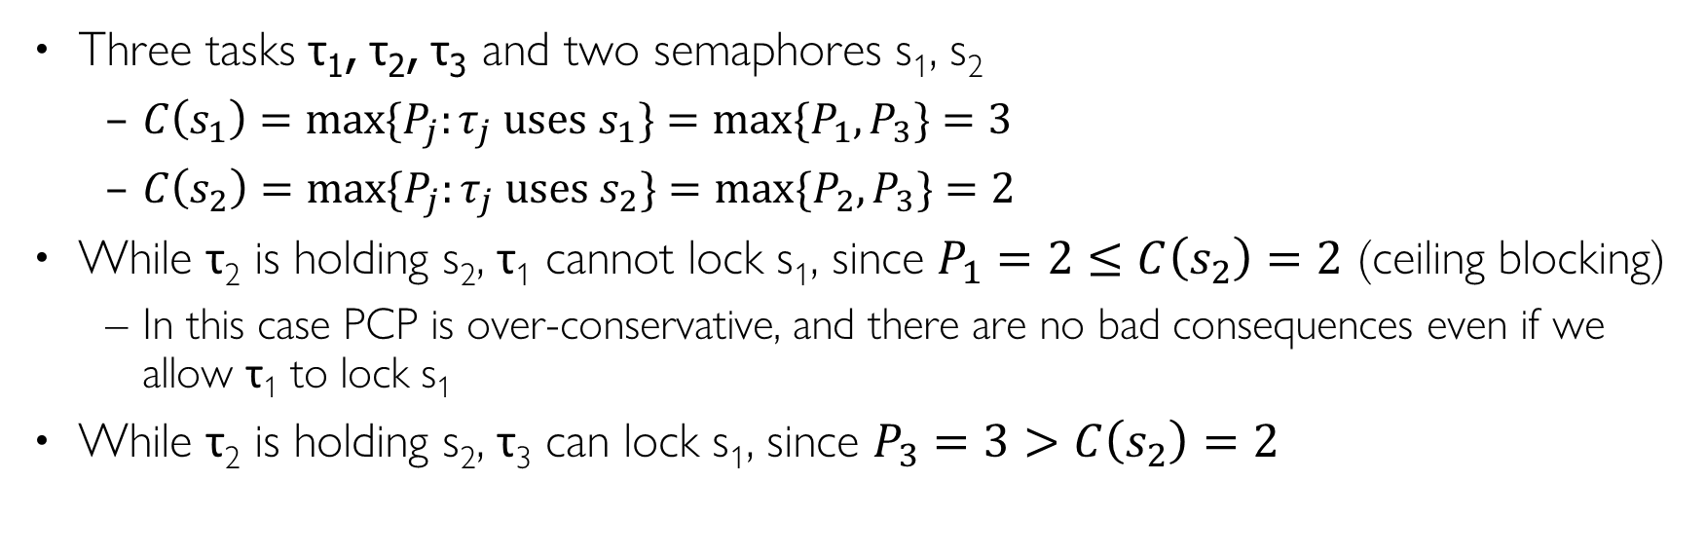
PCP Example II
Three tasks τ₁, τ₂, τ₃ and two semaphores s₁, s₂
  $C\left(s_{1}\right)=\max{\{P_{j}:τ_{j} uses s_{1}\}}=\max{\{P_{1}, P_{3}\}}=3$
  $C\left(s_{2}\right)=\max{\{P_{j}:τ_{j} uses s_{2}\}}=\max{\{P_{1}, P_{2}\}}=2$
While τ₂ is holding s₂, τ₁ cannot lock s₁, since $P_{1}=2≤C\left(s_{2}\right)=2$ (ceiling blocking)
  In this case PCP is over-conservative, and there are no bad consequences even if we allow τ₁ to lock s₁
While τ₂ is holding s₂, τ₃ can lock s₁, since $P_{3}=3>C\left(s_{2}\right)=2$
s₁
s₂
C(s₁)=3
C(s₂)=2
Task | Prio | sems
τ₁ | 2 | s₁, s₂
τ₂ | 1 | s₂
τ₃ | 3 | s₁
sem | Ceil
s₁ | 3
s₂ | 2
τ₃ (P₃=3)
τ₁ (P₁=2)
τ₂ (P₂=1)
Notes:
Ceiling blocking is “preventive blocking”, since $τ_{2}$ is blocked by $τ_{4}$, even though τ₂ tries to lock s₁ which is free. This prevents any potential deadlocks in the future, when τ₂, τ₄ each holds one of s₁, s₂ and tries to lock the other

Slide 48
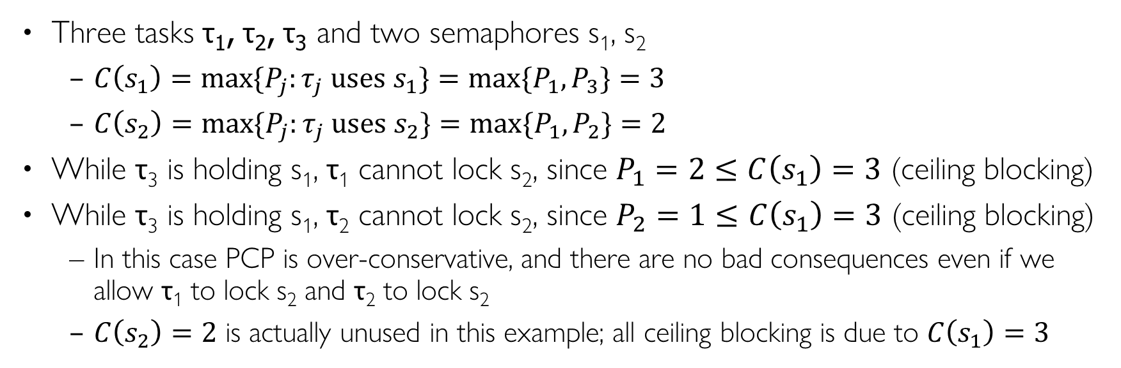
PCP Example II
Three tasks τ₁, τ₂, τ₃ and two semaphores s₁, s₂
  $C\left(s_{1}\right)=\max{\{P_{j}:τ_{j} uses s_{1}\}}=\max{\{P_{1}, P_{3}\}}=3$
  $C\left(s_{2}\right)=\max{\{P_{j}:τ_{j} uses s_{2}\}}=\max{\{P_{1}, P_{2}\}}=2$
While τ₃ is holding s₁, τ₁ cannot lock s₂, since $P_{1}=2≤C\left(s_{1}\right)=3$ (ceiling blocking)
While τ₃ is holding s₁, τ₂ cannot lock s₂, since $P_{2}=1≤C\left(s_{1}\right)=3$ (ceiling blocking)
  In this case PCP is over-conservative, and there are no bad consequences even if we allow τ₁ to lock s₂ and τ₂ to lock s₂
  $C\left(s_{2}\right)=2$ is actually unused in this example; all ceiling blocking is due to $C\left(s_{1}\right)=3$
s₁
s₂
C(s₁)=3
C(s₂)=2
Task | Prio | sems
τ₁ | 2 | s₁, s₂
τ₂ | 1 | s₂
τ₃ | 3 | s₁
sem | Ceil
s₁ | 3
s₂ | 2
τ₃ (P₃=3)
τ₁ (P₁=2)
τ₂ (P₂=1)
Notes:
Ceiling blocking is “preventive blocking”, since $τ_{2}$ is blocked by $τ_{4}$, even though τ₂ tries to lock s₁ which is free. This prevents any potential deadlocks in the future, when τ₂, τ₄ each holds one of s₁, s₂ and tries to lock the other

Slide 49
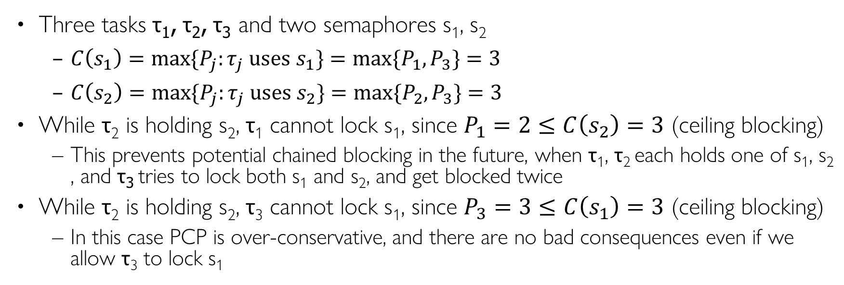
PCP Example II
Three tasks τ₁, τ₂, τ₃ and two semaphores s₁, s₂
  $C\left(s_{1}\right)=\max{\{P_{j}:τ_{j} uses s_{1}\}}=\max{\{P_{1}, P_{3}\}}=3$
  $C\left(s_{2}\right)=\max{\{P_{j}:τ_{j} uses s_{2}\}}=\max{\{P_{2}, P_{3}\}}=3$
While τ₂ is holding s₂, τ₁ cannot lock s₁, since $P_{1}=2≤C\left(s_{2}\right)=3$ (ceiling blocking)
  This prevents potential chained blocking in the future, when τ₁, τ₂ each holds one of s₁, s₂ , and τ₃ tries to lock both s₁ and s₂, and get blocked twice
While τ₂ is holding s₂, τ₃ cannot lock s₁, since $P_{3}=3≤C\left(s_{2}\right)=3$ (ceiling blocking)
  In this case PCP is over-conservative, and there are no bad consequences even if we allow τ₃ to lock s₁
s₁
s₂
C(s₁)=3
C(s₂)=3
Task | Prio | sems
τ₁ | 2 | s₁
τ₂ | 1 | s₂
τ₃ | 3 | s₁, s₂
sem | Ceil
s₁ | 3
s₂ | 3
τ₃ (P₃=3)
τ₁ (P₁=2)
τ₂ (P₂=1)
Notes:
Ceiling blocking is “preventive blocking”, since $τ_{2}$ is blocked by $τ_{4}$, even though τ₂ tries to lock s₁ which is free. This prevents any potential deadlocks in the future, when τ₂, τ₄ each holds one of s₁, s₂ and tries to lock the other
This prevents any potential deadlocks in the future, when τ₁, τ₂ each holds one of s₁, s₂ and tries to lock the other

Slide 50
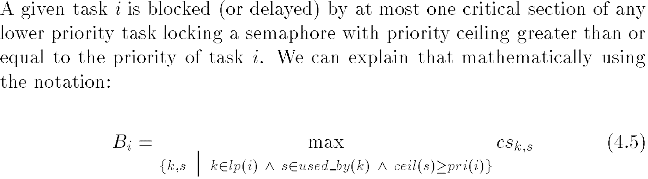
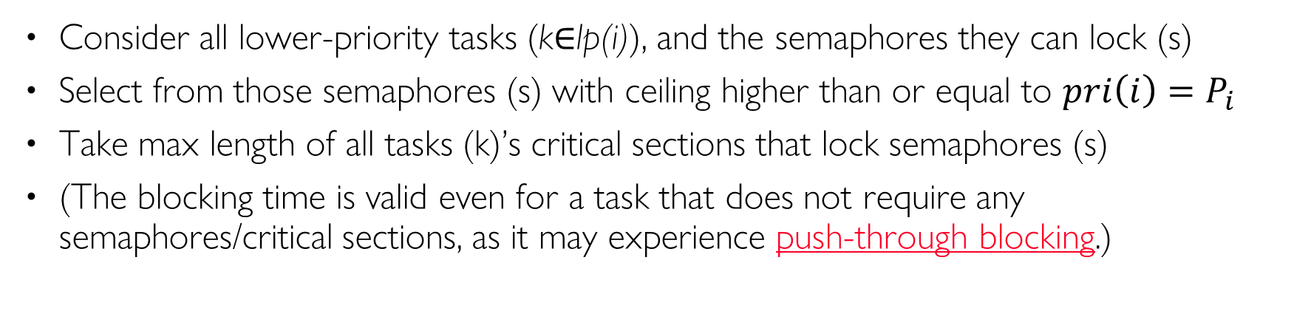
PCP Blocking Time
IMPORTANT
Consider all lower-priority tasks (k$∈$lp(i)), and the semaphores they can lock (s)
Select from those semaphores (s) with ceiling higher than or equal to ${pri\left(i\right)=P}_{i}$
Take max length of all tasks (k)’s critical sections that lock semaphores (s)
(The blocking time is valid even for a task that does not require any semaphores/critical sections, as it may experience push-through blocking.)
Notes:
. Blocking delay is MAX length of critical sections of all lower-priority tasks (vs. SUM for PIP)

Slide 51
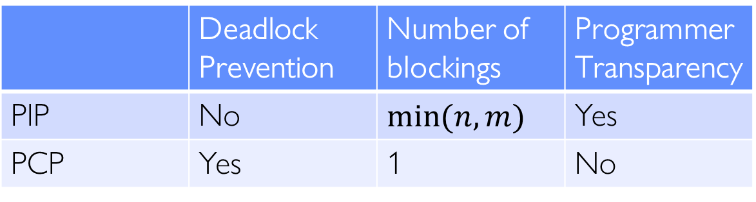

PCP Pros and Cons
Pros:
  It prevents unbounded priority inversion, deadlocks, and chained blocking
  Any given task is blocked at most once by a lower-priority task
Cons:
  It is not transparent to the programmer, as shared resources required by all tasks must be known a priori at design time, and programmer needs to calculate priority ceilings of all semaphores and pass them to the OS (PIP does not need this step)
 | Deadlock Prevention | Number of blockings | Programmer Transparency
PIP | No | $$\min{(n,m)}$$ | Yes
PCP | Yes | 1 | No
  # blockings under PIP:$n$ is the number of tasks with priority lower than $τ_{i}$;$m$ is the number of locks/semaphores on which $τ_{i}$can be blocked
Notes:
Using PCP, each task can be blocked at most once. For PCP, in addition to normal and push-through blocking:
Ceiling blocking: τ_{i} tried to lock s, but ceilings of currently locked semaphores are higher than P_{i} (s may be free)
Perform schedulability analysis by including the blocking terms
Transparency:
PIP is transparent to the programmer; PCP and SRP require the programmer to manually calculate semaphore priority ceiling values and pass them to the OS
in order to calculate ceilings of all semaphores

Slide 52
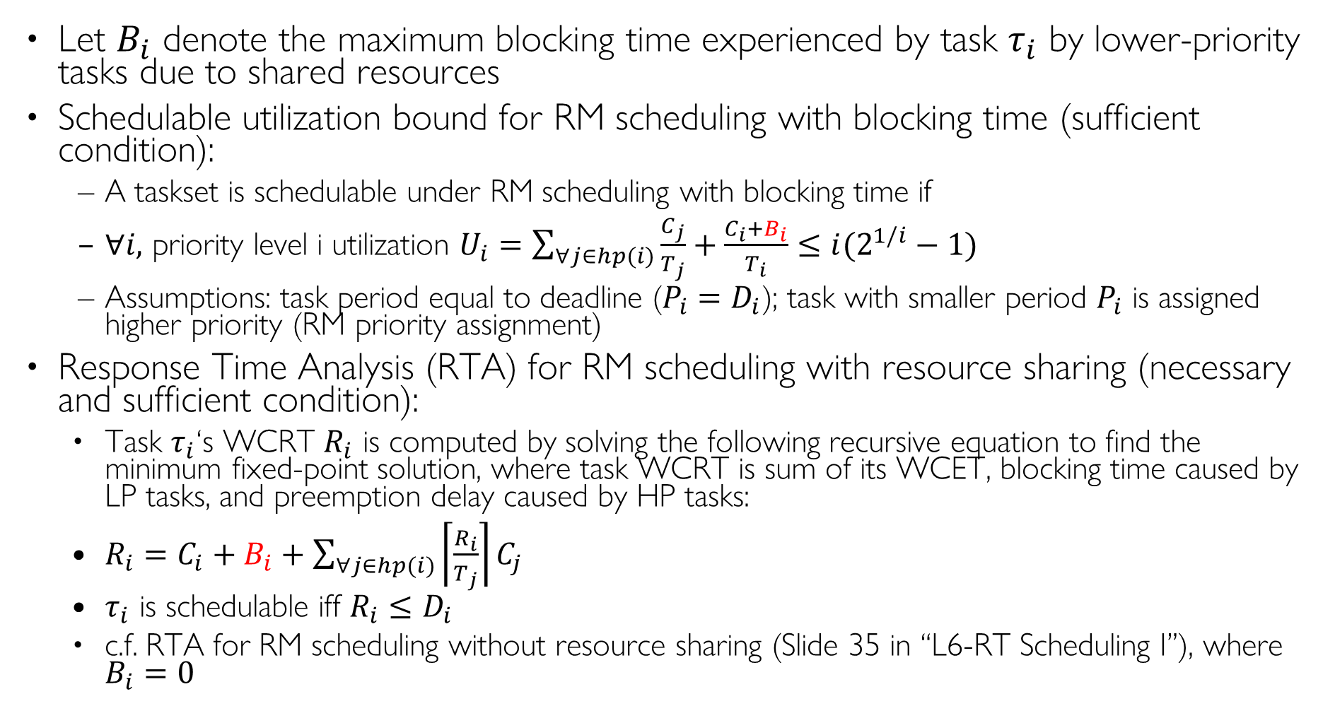
Schedulability Analysis under PIP and PCP
Let $B_{i}$ denote the maximum blocking time experienced by task $τ_{i}$ by lower-priority tasks due to shared resources
Schedulable utilization bound for RM scheduling with blocking time (sufficient condition):
  A taskset is schedulable under RM scheduling with blocking time if
  $∀i,$ priority level i utilization $U_{i}=\sum_{∀j∈hp(i)}{\frac{C_{j}}{T_{j}}}+\frac{C_{i}+B_{i}}{T_{i}}≤i(2^{1/i}−1)$
  Assumptions: task period equal to deadline ($T_{i}=D_{i}$); task with smaller period $T_{i}$ is assigned higher priority (RM priority assignment)
Response Time Analysis (RTA) for RM scheduling with resource sharing (necessary and sufficient condition):
  Task $τ_{i}$‘s WCRT $R_{i}$ is computed by solving the following recursive equation to find the minimum fixed-point solution, where task WCRT is sum of its WCET, blocking time caused by LP tasks, and preemption delay caused by HP tasks:
  $R_{i}=C_{i}+B_{i}+\sum_{∀j∈hp(i)}{\left\lceil \frac{R_{i}}{T_{j}}\right\rceil C_{j}}$
  $τ_{i}$ is schedulable iff ${R_{i}≤D}_{i}$
  c.f. RTA for RM scheduling without resource sharing (Slide 35 in “L6-RTScheduling I”), where $B_{i}=0$
Notes:
Task index k is in the order of decreasing preemption level π_{i}
1st term denotes utilization of all tasks with higher preemption level; 2nd term contains blocking time due to tasks with lower preemption level

Slide 53
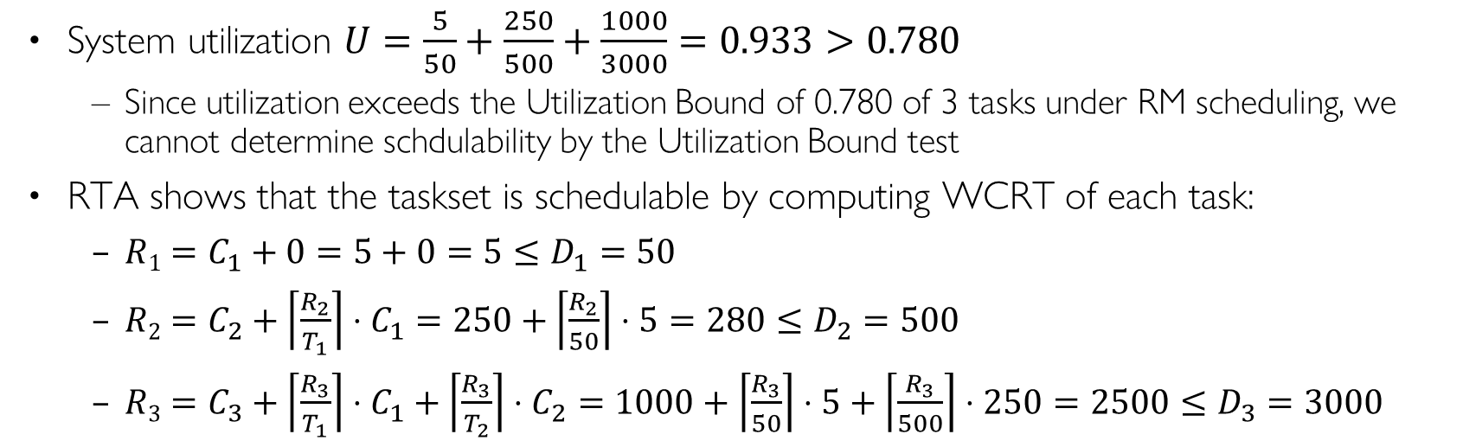
Example Taskset (without shared resources)
System utilization $U=\frac{5}{50}+\frac{250}{500}+\frac{1000}{3000}=0.933>0.780$
  Since utilization exceeds the Utilization Bound of 0.780 of 3 tasks under RM scheduling, we cannot determine schedulability by the Utilization Bound test
RTA shows that the taskset is schedulable by computing WCRT of each task:
  $R1=C_{1}+0=5+0=5≤D_{1}=50$
  $R2=C_{2}+\left\lceil \frac{R_{2}}{T_{1}}\right\rceil ⋅C_{1}=250+\left\lceil \frac{R_{2}}{50}\right\rceil ⋅5=280≤D_{2}=500$
  $R3=C_{3}+\left\lceil \frac{R_{3}}{T_{1}}\right\rceil ⋅C_{1}+\left\lceil \frac{R_{3}}{T_{2}}\right\rceil ⋅C_{2}=1000+\left\lceil \frac{R_{3}}{50}\right\rceil ⋅5+\left\lceil \frac{R_{3}}{500}\right\rceil ⋅250=2500≤D_{3}=3000$
Task | T | D | C | Prio | R
1 | 50 | 50 | 5 | H | 5
2 | 500 | 500 | 250 | M | 280
3 | 3000 | 3000 | 1000 | L | 2500
Notes:
1000+250+1250=2500
5/50+250/500+1000/3000=

Slide 54

Example Taskset (with shared resources under PCP) I
3 semaphores s₁, s₂, s₃
  Task 1 requires semaphore s₁, with CS length 1
  Task 2 requires semaphores s₂ and s₃, with CS lengths 2 and 5, respectively
  Task 3 requires semaphores s₂ and s₃, with CS lengths 3 and 4, respectively
Ceilings $C(s1)=P_{1}=H; C(s2)=C(s3)=max⁡(P_{2},P_{3})=M$
Blocking times:
  Task 1: $B1=0$ (Task 1 does not experience any blocking since its priority is higher than ceilings of s₂ and s₃: $P_{1}>C\left(s_{2}\right)=C\left(S_{3}\right)=M$), so it remains schedulable
  Task 2: $B2=\max\left(3, 4\right)=4$ (maximum CS length of LP Task 3 since $P_{2}≤C\left(s_{2}\right)=C\left(S_{3}\right)=M$)
    Utilization $U_{2}=\sum_{∀j∈hp(2)}{\frac{C_{j}}{T_{j}}}+\frac{C_{2}+B_{2}}{T_{2}}=\frac{5}{50}+\frac{250+4}{500}=0.608≤0.828$ (utilization bound for 2 tasks under RM)
    Or WCRT: $R2=C_{2}+B_{2}+\left\lceil \frac{R_{2}}{T_{1}}\right\rceil ⋅C_{1}=250+4+\left\lceil \frac{R_{2}}{50}\right\rceil ⋅5=284≤D_{2}=500$
  Task 3: $B3=0$ (Task 3 is the lowest priority task, so it does not experience any blocking), so it remains schedulable
The taskset remains schedulable with shared resources under PCP
Task | T | D | C | Prio | sems | CS Len | B | R
1 | 50 | 50 | 5 | H | s₁ | 1 | 0 | 5
2 | 500 | 500 | 250 | M | s₂, s₃ | 2, 5 | 4 | 284
3 | 3000 | 3000 | 1000 | L | s₂, s₃ | 3, 4 | 0 | 2500
sem | Ceiling
s₁ | H
s₂ | M
s₃ | M
Notes:
Critical sections associated with semaphores s1, s2 and s3
Task 1 (A): …lock(s₁)…unlock(s₁)…
Task 2 (B): …lock(s₂)…lock(s₃)… unlock(s₃)…unlock(s₂)…
Task 3 (C): …lock(s₃)…lock(s₂)… unlock(s₂)…unlock(s₃)…

Slide 55

Example Taskset (with shared resources under PCP) II
3 semaphores s₁, s₂, s₃
  Task 1 requires semaphores s₁, s₂ and s₃ with CS lengths 1, 1, 1
  Task 2 requires semaphores s₂ and s₃, with CS lengths 2 and 5, respectively
  Task 3 requires semaphores s₂ and s₃, with CS lengths 3 and 4, respectively
Ceilings $C(s1)=P_{1}=H; C(s2)=C(s3)=max⁡(P_{1}, P_{2},P_{3}) =H$
Blocking times:
  Task 1: $B1=\max{(2, 5, 3, 4)}=5$ (maximum CS length of LP Tasks 2 and 3, since $P_{1}≤C\left(s_{2}\right)=C\left(S_{3}\right)=H$)
    Utilization $U_{1}=\sum_{∀j∈hp(1)}{\frac{C_{j}}{T_{j}}}+\frac{C_{1}+B_{1}}{T_{1}}=0+\frac{5+5}{50}=0.2≤1$ (Utilization bound for 1 task under RM), so Task 1 remains schedulable
    Or WCRT: $R1=C_{1}+B_{1}=5+5=10≤D_{1}=50$
    (Task 1’s CS lengths (1, 1, 1) do not matter since it is the highest priority task and does not block any other task)
  Task 2: $B2=\max\left(3, 4\right)=4$ (maximum CS length of LP Task 3, since $P_{2}≤C\left(s_{2}\right)=C\left(S_{3}\right)=H$)
  Task 3: $B3=0$ (Task 3 is the lowest priority task, so it does not experience blocking), so it remains schedulable
    Same calculation of utilization and WCRT for Tasks 2 and 3 as before
The taskset remains schedulable with shared resources under PCP
Task | T | D | C | Prio | sems | CS Len | B | R
1 | 50 | 50 | 5 | H | s₁,s₂,s₃ | 1, 1, 1 | 5 | 10
2 | 500 | 500 | 250 | M | s₂, s₃ | 2, 5 | 4 | 284
3 | 3000 | 3000 | 1000 | L | s₂, s₃ | 3, 4 | 0 | 2500
sem | Ceiling
s₁ | H
s₂ | H
s₃ | H
Notes:
Critical sections associated with semaphores s₂ and s₃
A: …lock(s₁)…unlock(s₁)…
B: …lock(s₂)…lock(s₃)… unlock(s₃)…unlock(s₂)…
C: …lock(s₃)…lock(s₂)… unlock(s₂)…unlock(s₃)…

Slide 56
Scheduling Anomaly w/ Resource Synchronization
Doubling processor speed causes T1 to miss its deadline
  (Yellow part denotes a critical section shared by T1 and T2)
Notes:
PIP and PCP by Srinivas
https://www.youtube.com/@srinivasbt/videos

